Slide 1
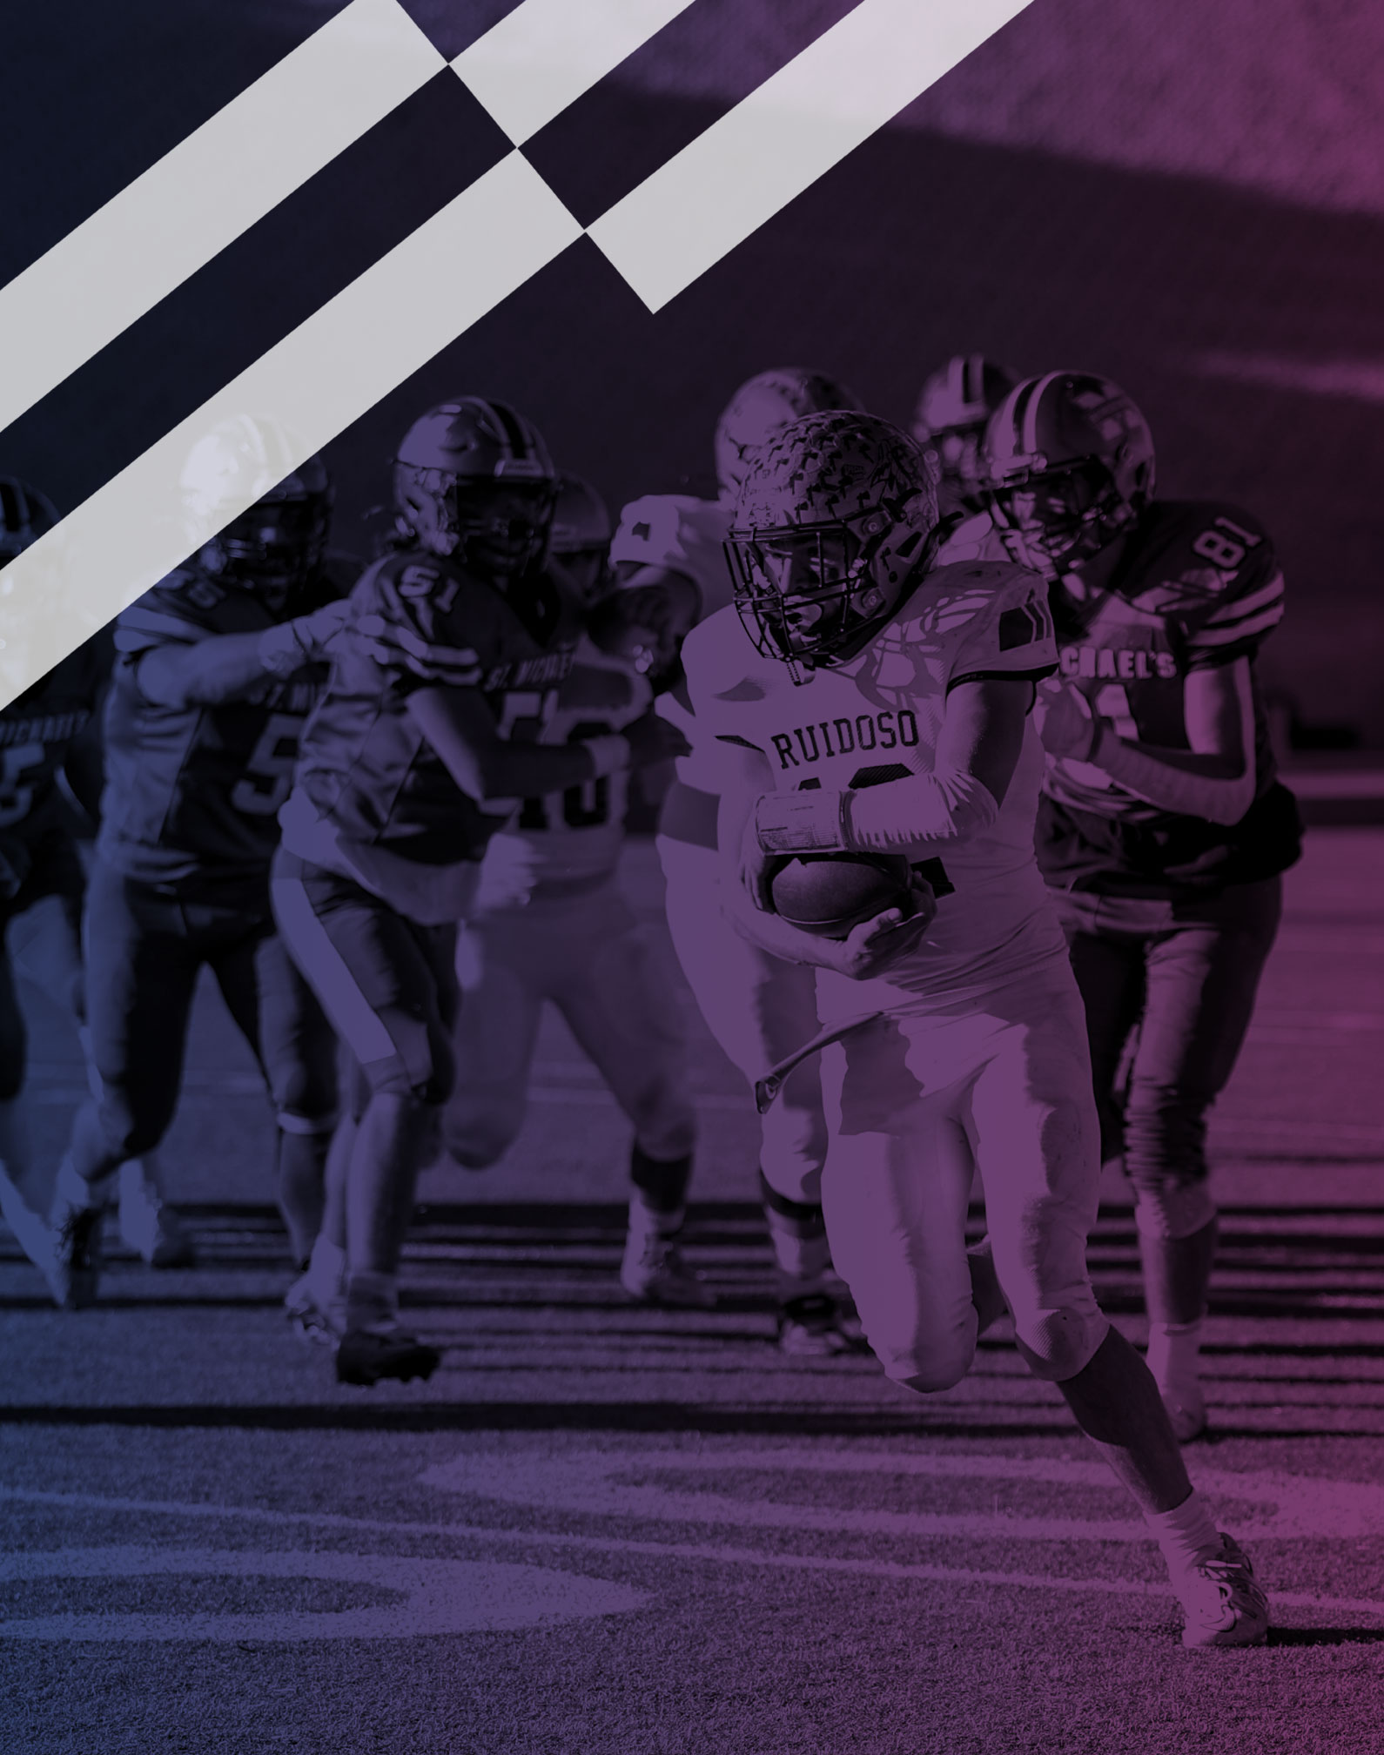
2026 NFHS FOOTBALL RULES POWERPOINT
Notes:
This PowerPoint presentation from the National Federation of State High School Associations (NFHS) covers the following:
2026 NFHS Football Rules Changes-
2026 NFHS Football Editorial Changes-
2026 NFHS Football Points of Emphasis-
2026 NFHS Football Rules Reminders-
2026 and 2027 NFHS Football Game Officials Manual Changes-
2026-27 NFHS Football Information-

Slide 2





2026 NJSIAA Rules Interpretation Team
NJFOA North- Mike Valenzano
NJFOA Central- Steve Citro
NJFOA Shore- Bill Surdovel
NJSIAA/NJFOA South- Mike Bartram

Slide 3
2026 NFHS FOOTBALL RULES CHANGES

Slide 4
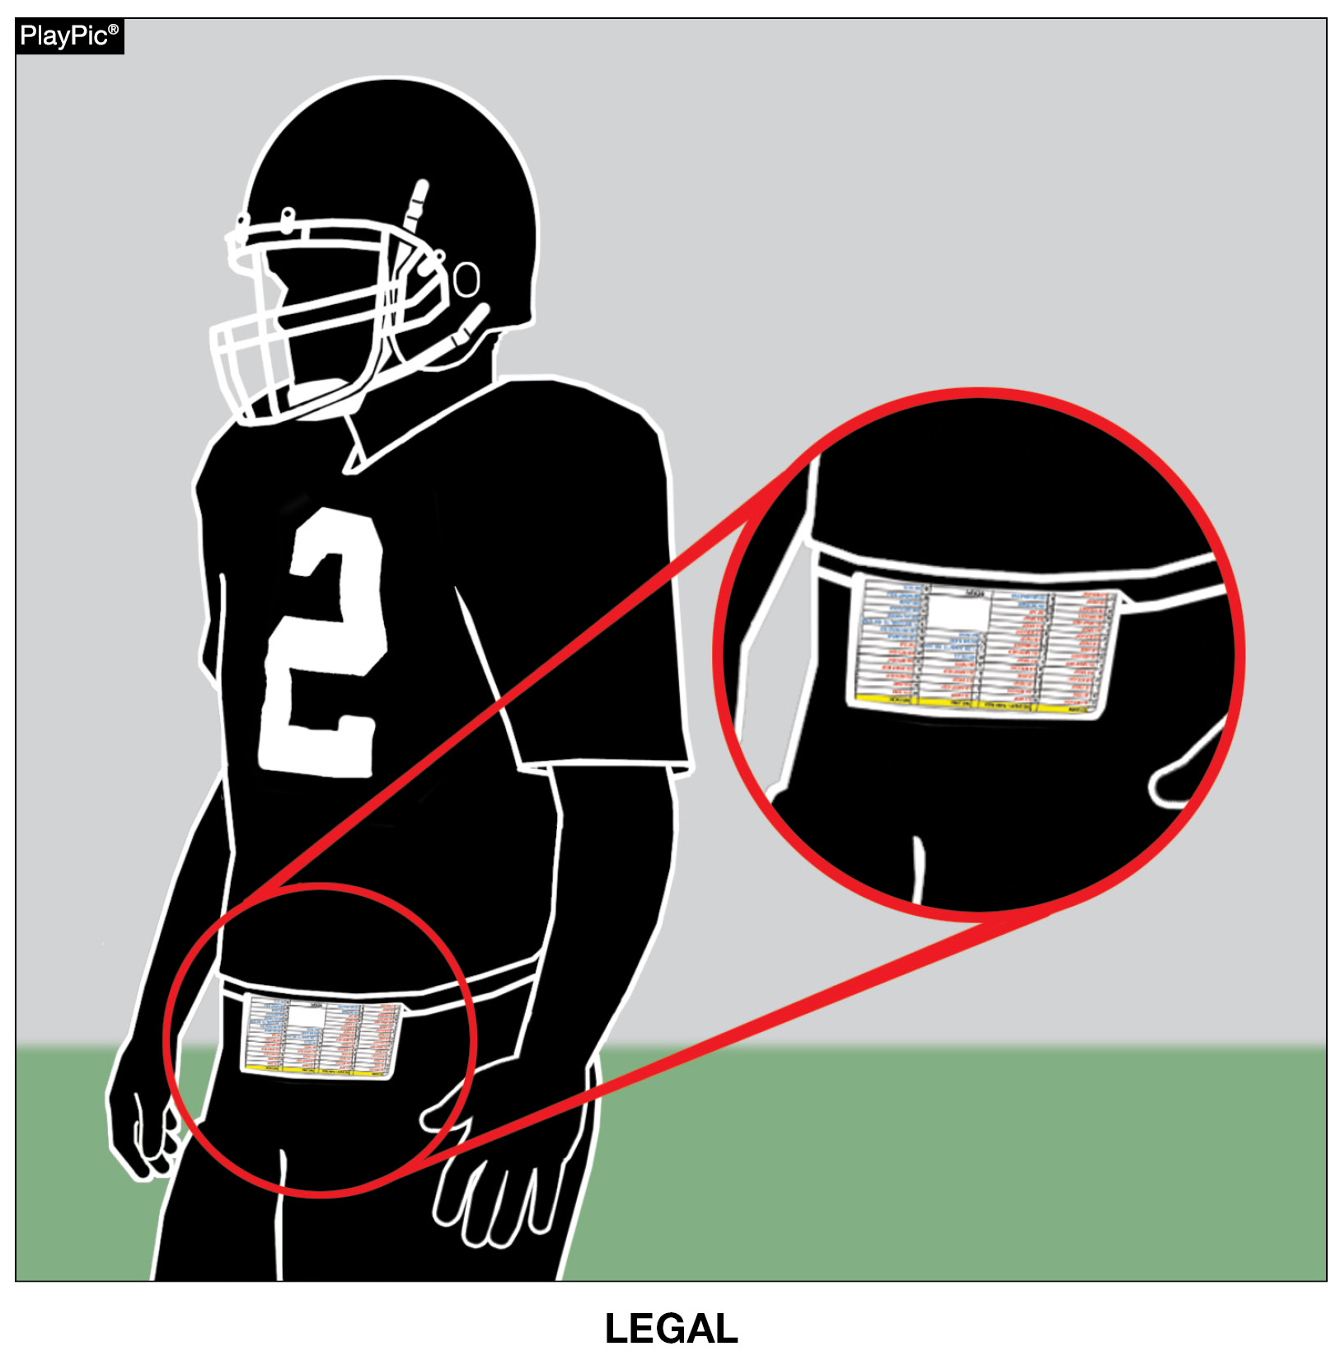
PLAY CARDS
RULE 1-5-3c(9)
“Illegal equipment shall always include but is not limited to:
9. Play cards not worn on the wrist, arm or belt.”
Notes:
RULE CHANGE:
RULE 1 – SECTION 5 PLAYER EQUIPMENT
ART. 3 . . . Illegal equipment. No player shall participate while wearing illegal equipment. This applies to any equipment, which in the opinion of the umpire is dangerous, confusing or inappropriate. Illegal equipment shall always include but is not limited to: …
c. The following Other Illegal Equipment: …
9. Play cards not worn on the wrist, arm or belt.
Comment on Change: The committee has approved the wearing of play cards on both the forearm/wrist and belt areas of the body.

Slide 5
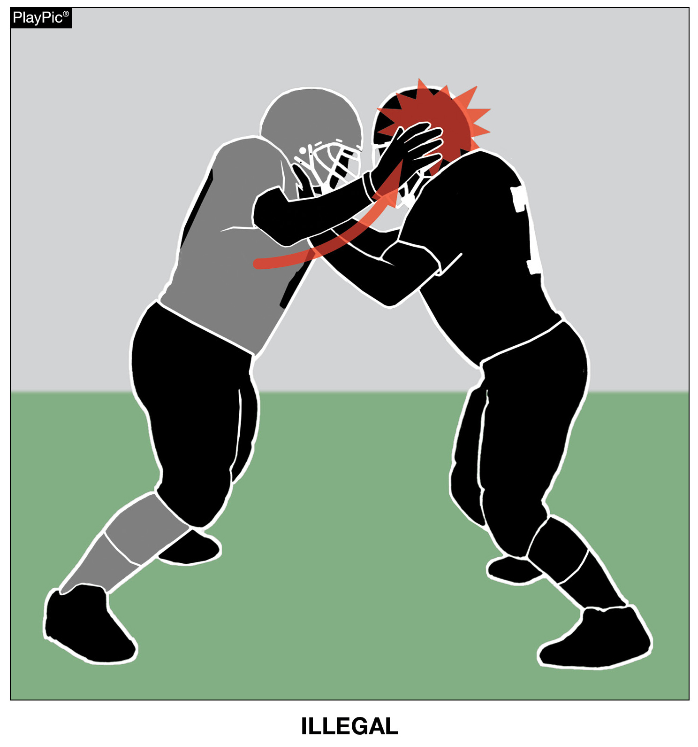
HEAD SLAP
RULE 9-4-7
“No player may use the hand(s) to slap the opponent’s head.”
Notes:
RULE CHANGE:
RULE 9 – SECTION 4 ILLEGAL PERSONAL CONTACT
ART. 7 . . . No player may use the hand(s) to slap the opponent's head.
Comment on Change: The committee approved new rules language that no player may use the hand(s) to slap the opponent’s head.
Case Book Situation: 9.4.7 SITUATION C

Slide 6
2026 NFHS FOOTBALL EDITORIAL CHANGES

Slide 7
GAME ENDING PROCEDURE
RULE 1-1-8
The game officials’ authority extends through the referee's declaration of the end of the fourth period or overtime. The jurisdiction of the game officials is terminated and the final score has been approved when all game officials leave the visual confines of the playing area. The game officials retain clerical authority over the game through the completion of any reports, including those imposing disqualifications, that are responsive to actions occurring while the game officials had jurisdiction. State Associations may intercede in the event of unusual incidents that occur before, during or after the game official’s jurisdiction has ended or in the event that a game is terminated prior to the conclusion of regulation play.
Notes:
EDITORIAL CHANGE:
RULE 1 – SECTION 1 THE GAME
ART. 8 . . . The game officials' authority extends through the referee's declaration of the end of the fourth period or overtime. The jurisdiction of the game officials is terminated and the final score has been approved when all game officials leave the visual confines of the playing area. The game officials retain clerical authority over the game through the completion of any reports, including those imposing disqualifications, that are responsive to actions occurring while the game officials had jurisdiction. State Associations may intercede in the event of unusual incidents that occur before, during or after the game officials' jurisdiction has ended or in the event that a game is terminated prior to the conclusion of regulation play.
Comment on Change: Further clarifies end of game procedures for game officials.
Case Book Situation: 1.1.8 SITUATION C

Slide 8
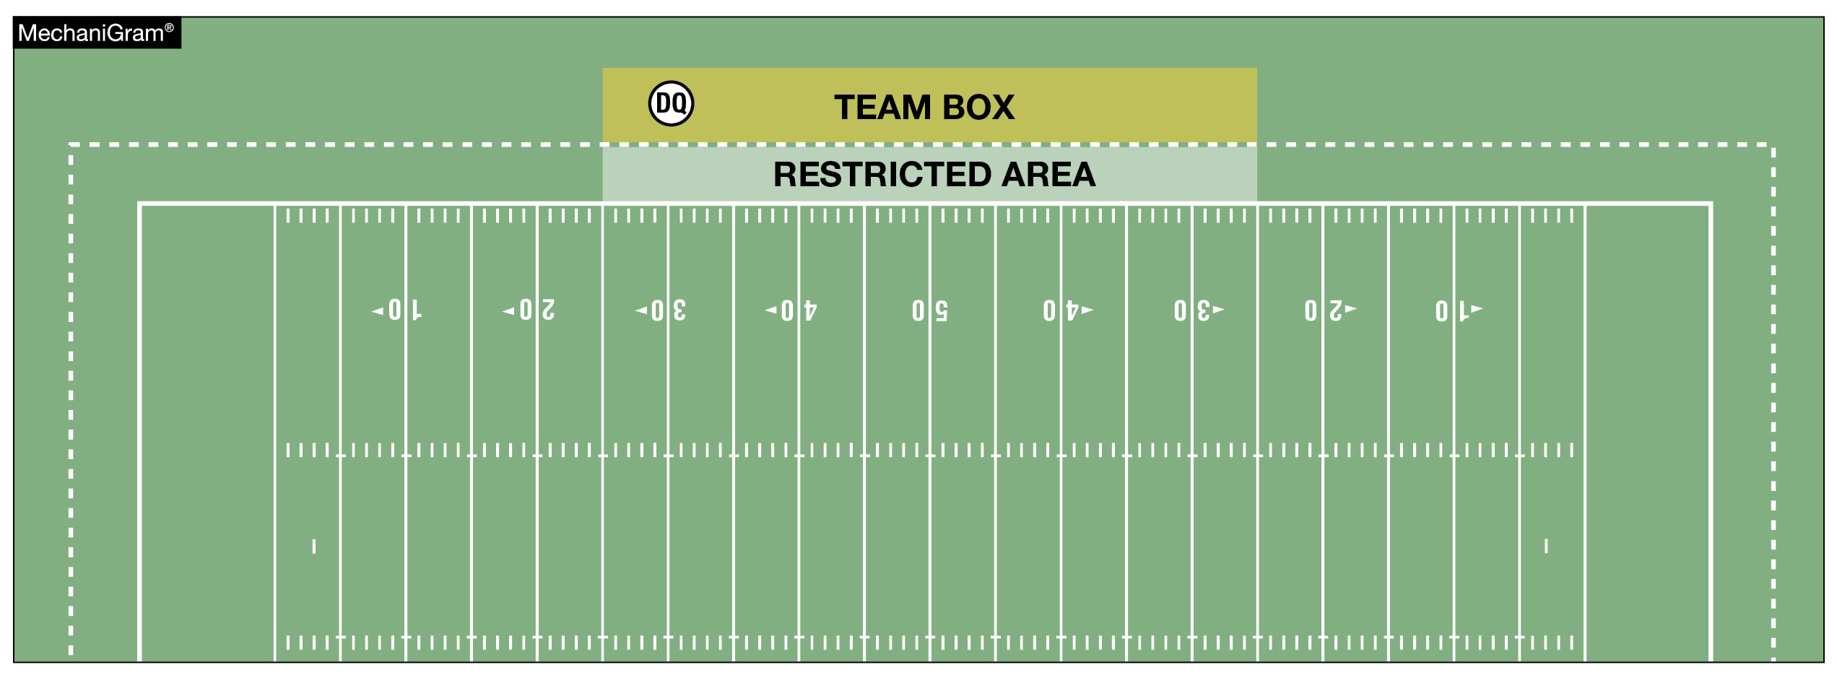
DISQUALIFIED PLAYER
RULE 2-32-6
A disqualified player is a player barred from further participation in a game. A disqualified player can be permitted to remain in the team box area.
Notes:
EDITORIAL CHANGE:
RULE 2 – SECTION 32 PLAYER DESIGNATIONS
ART. 6 . . . A disqualified player is a player barred from further participation in a game. A disqualified player can be permitted to remain in the team box area.
Comment on Change: Clarifies that a disqualified player can remain in the team box if the state association allows an ejected player to remain at the venue.

Slide 9
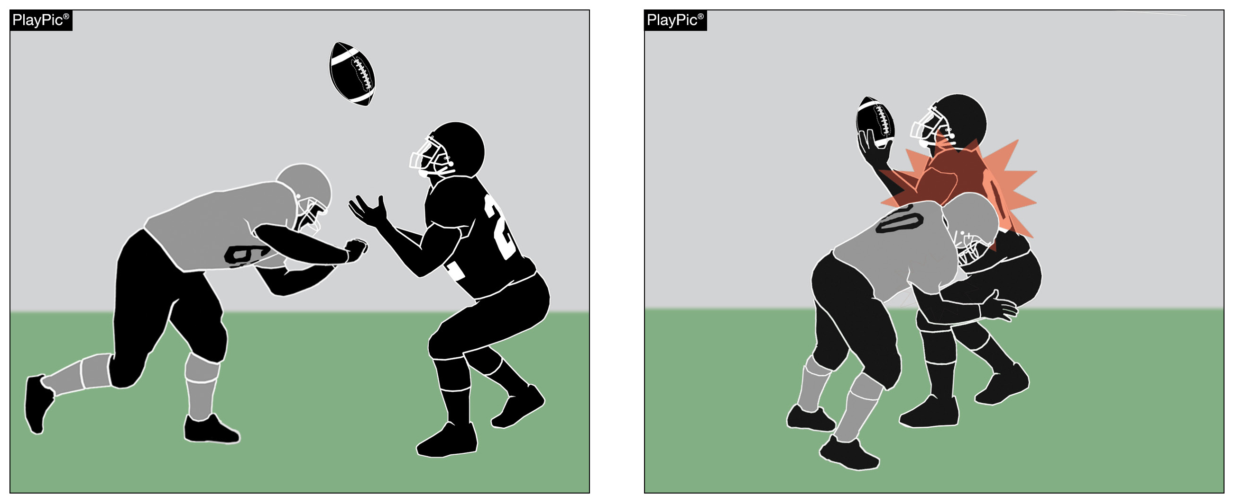
ILLEGAL PERSONAL CONTACT/DEFENSELESS PLAYER
RULE 9-4-3p
No player or nonplayer shall:
  p. Initiate forceful contact against a defenseless receiver as in 2-32-16b, 2-32-16c and 2-32-16e that is not:
    1. Incidental contact as a result of making a play on the ball;
    2. Initiated with open hands; or
    3. An attempt to tackle by wrapping arm(s) around the receiver.
Notes:
EDITORIAL CHANGE:
RULE 9 – SECTION 4 ILLEGAL PERSONAL CONTACT
ART. 3 . . . No player or nonplayer shall: …
p. Initiate forceful contact against a defenseless receiver as in 2-32-16b, 2-32-16c and 2-32-16e that is not:
1. Incidental contact as a result of making a play on the ball;
2. Initiated with open hands; or
3. An attempt to tackle by wrapping arm(s) around the receiver.
Comment on Change: Clarifies type of contact against a kick receiver that is illegal.

Slide 10
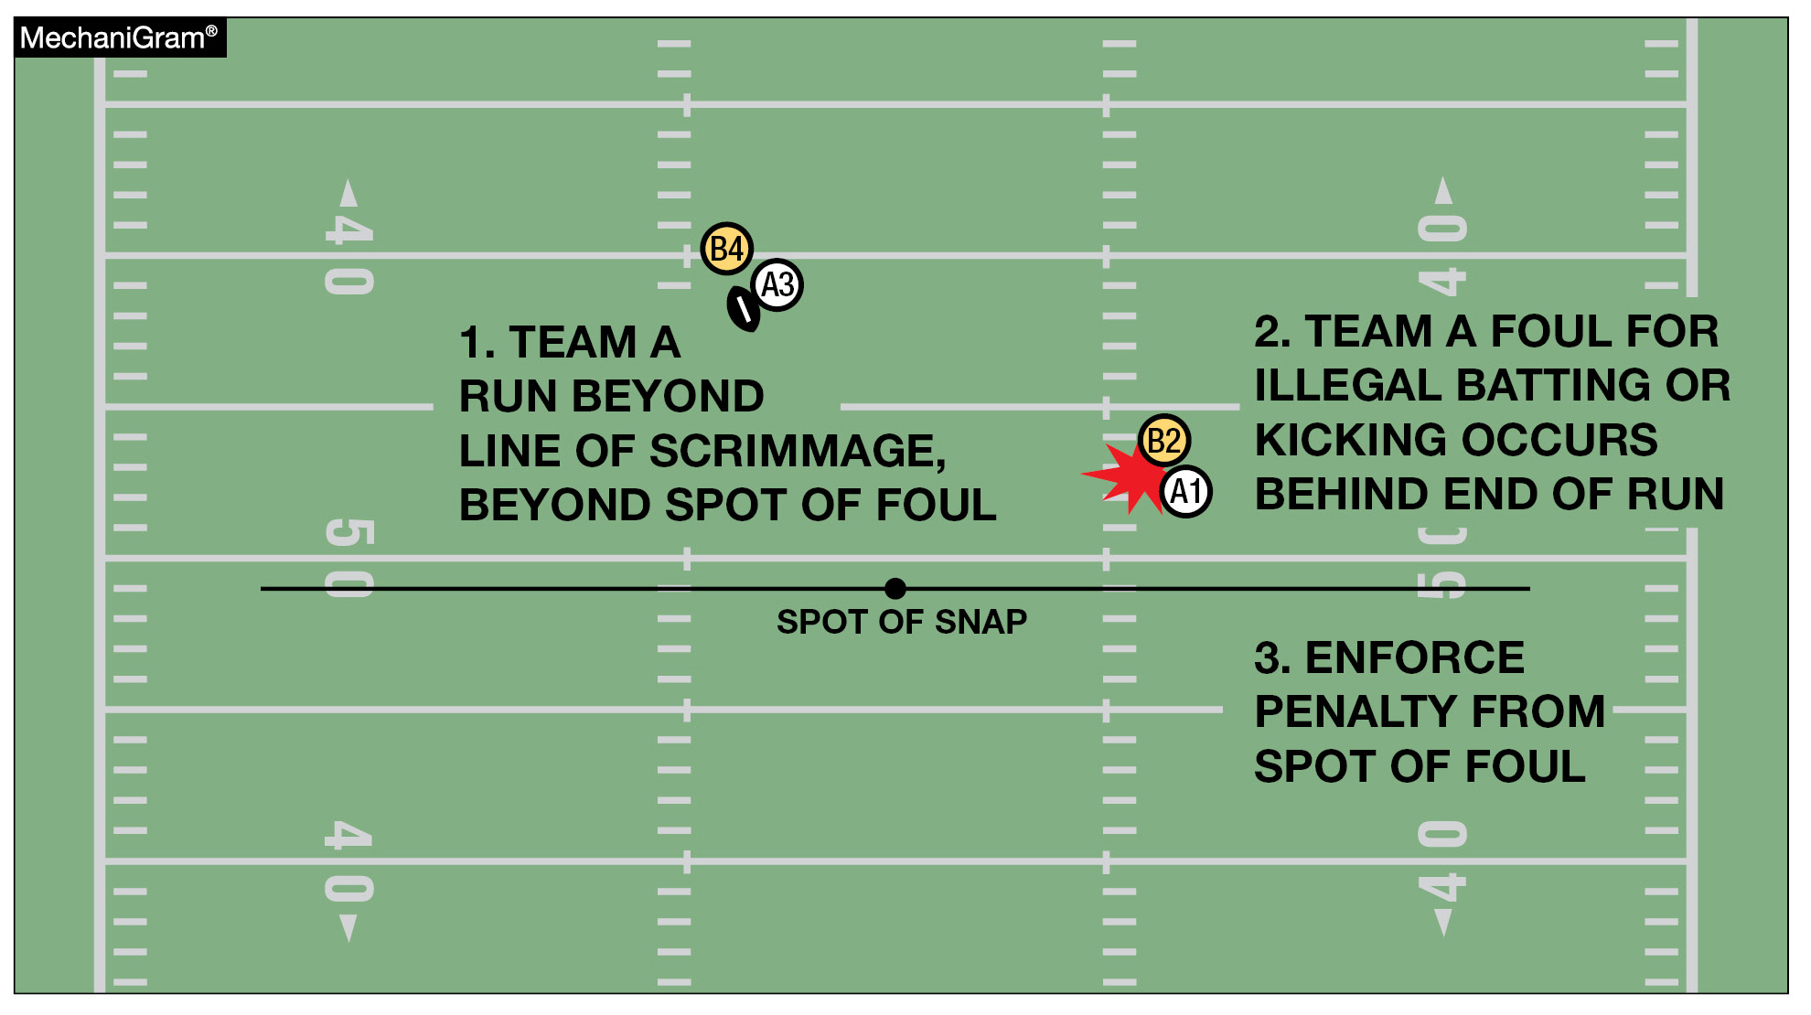
BASIC SPOT
RULE 10-4-4a
The basic spot is the spot of the foul for:
a. Illegal batting or illegal kicking by A that occurs behind the basic spot.
Notes:
EDITORIAL CHANGE:
RULE 10 – SECTION 4 BASIC SPOTS
ART. 4 . . . The basic spot is the spot of the foul for:
a. Illegal batting or illegal kicking by A that occurs behind the basic spot; …
Comment on Change: Further clarifies the basic spot for illegal batting or kicking by A.

Slide 11
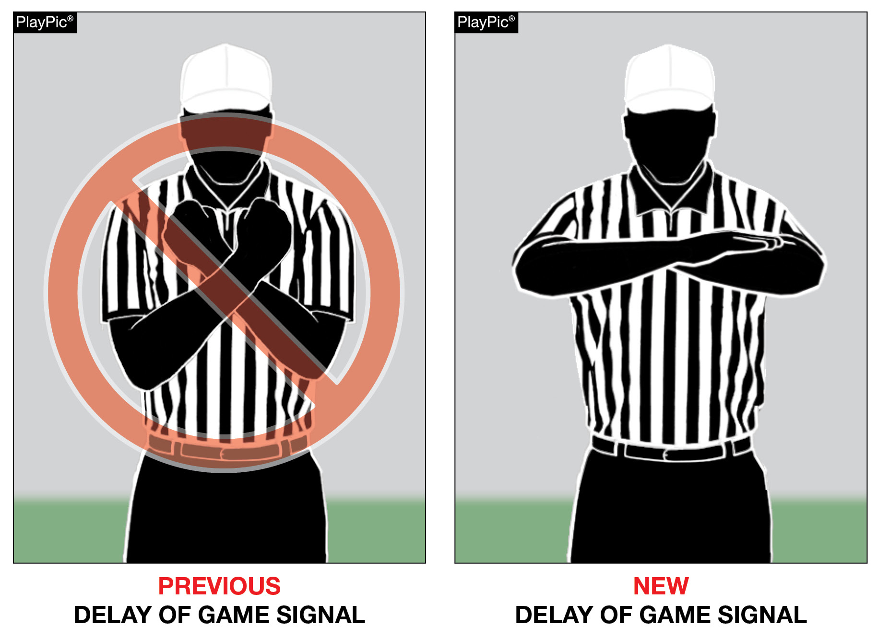
NEW DELAY OF GAME SIGNAL
Notes:
EDITORIAL CHANGE:
NFHS OFFICIAL FOOTBALL SIGNALS – Signal #21 – Delay of Game
Comment on Change: The NFHS Football Game Officials Manual Committee recommended changing Signal #21 – Delay of Game – to folded crossed arms in front of the body for 2026. The NFHS Football Rules Editorial Committee approved this change.

Slide 12
2026 NFHS FOOTBALL EDITORIAL CHANGES
1-3-5b | Changed “Head Linesman” to “Head Line Judge.
1-5-3a(2) | Deleted the reference to “opponent.”
2-15-1 | Further clarified to make definition more consistent with forward fumble rule that was approved in 2025.
3-5-7g | Replaced “heat and humidity” with “circumstances and conditions” better covers a variety of situations that may create a health risk to players.
4-1-3 | Deleted “if elected” from the rule as it was not needed.
5-3-1 | Added “ball being” before ready-for-play for clarification.
5-3-2 | Changed “Head Linesman” to “Head Line Judge.
8-2-2, 8-2-3, 8-2-4, 8-2-5 | Changed “subsequent kickoff” to “succeeding spot” for clarification.
Notes:
EDITORIAL CHANGES:
Comment on Slide:
This slide lists the rules references and a brief description of the additional football editorial changes that were made to the 2026 NFHS Football Rules Book.

Slide 13
2026 NFHS FOOTBALL EDITORIAL CHANGES
9-8 PENALTY | Added ‘basic spot” to the PENALTY section to give better clarity that unsportsmanlike and nonplayer unsportsmanlike fouls are enforced from the basic spot.
10-4-2 | Revised the rules references in the rule.
10-4-2b | Deleted “behind the line of scrimmage” from the rule to eliminate redundancy.
10-5-3 | Deleted “and enforcement is from behind its goal line” to eliminate conflicts with recent rules changes to Rule 10-4.
FOOTBALL FUNDAMENTAL – Penalty Measurement (4) | Removed all of the rules references and relaced with “otherwise specified by rule.”
RESOLVING TIED GAMES – (3-1) | Changed “Head Linesman” to “Head Line Judge.
6-Player Rules Differences – Rule 7 | Further clarified when a passer becomes eligible if the pass was touched by B.
Notes:
EDITORIAL CHANGES:
Comment on Slide:
This slide lists the rules references and a brief description of the additional football editorial changes that were made to the 2026 NFHS Football Rules Book.

Slide 14
2026 NFHS FOOTBALL RULES REMINDERS

Slide 15
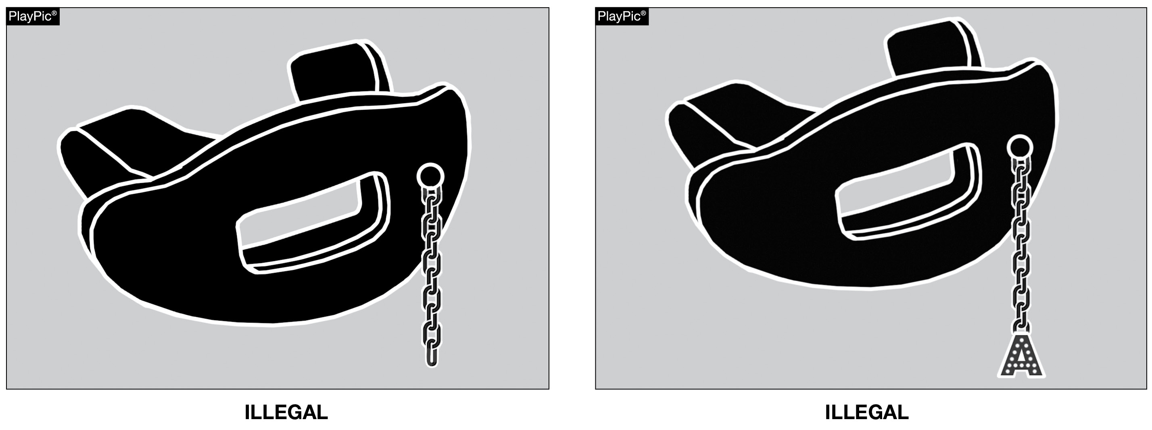
TOOTH & MOUTH PROTECTOR
RULE 1-5-1d(5)a – 4
Effective 2026: Tooth and mouth protectors may not include any attachment(s) that do not serve a purpose and function in protecting the teeth or mouth.
Notes:
RuleS Reminder:
See PlayPics and comments on slide.

Slide 16
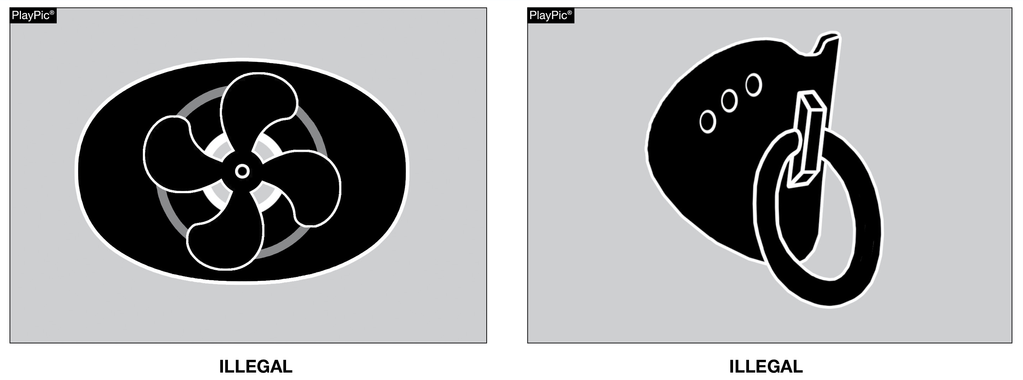
TOOTH & MOUTH PROTECTOR
RULE 1-5-1d(5)a – 5
Effective 2026: Tooth and mouth protectors may not include anything on them that is a health or risk issue and can pose a danger to themselves or other players.
Notes:
RuleS Reminder:
See PlayPics and comments on slide.

Slide 17
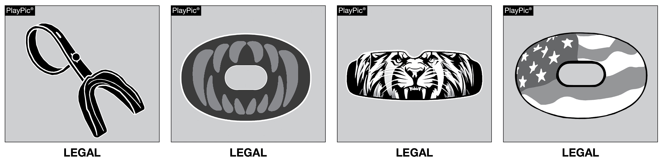
TOOTH & MOUTH PROTECTOR
RULES 1-5-1d(5)a – 4, 5
These tooth and mouth protectors neither include any attachment(s) that does not serve a purpose and function in protecting the teeth or mouth, nor anything that is a health or risk issue posing a danger and are not impacted by this rule change.
Notes:
RuleS Reminder:
See PlayPics and comments on slide.

Slide 18
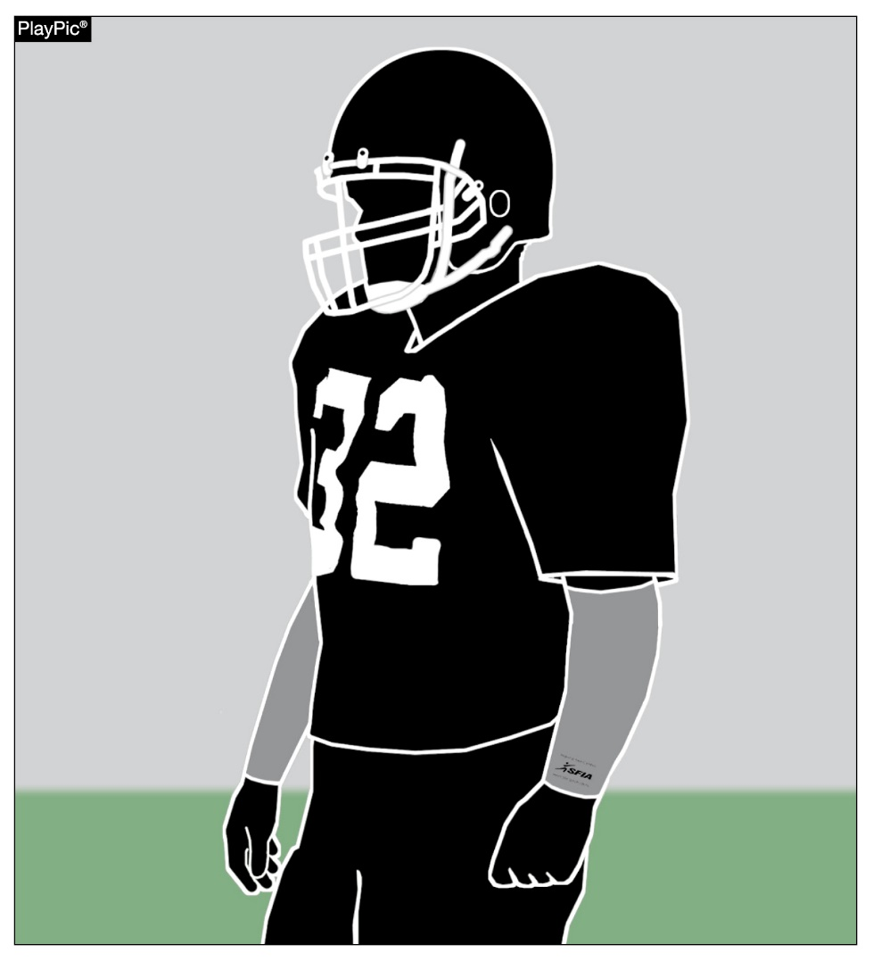
ARM SLEEVES
RULES 1-5-2d, 1-5-3c(6)
Effective 2027: Arm sleeves, whether attached to a shirt or unattached, manufactured to enhance contact with the football or opponent must meet the SFIA Specification at the time of manufacture.
Notes:
RuleS Reminder:
See PlayPic and comments on slide.

Slide 19
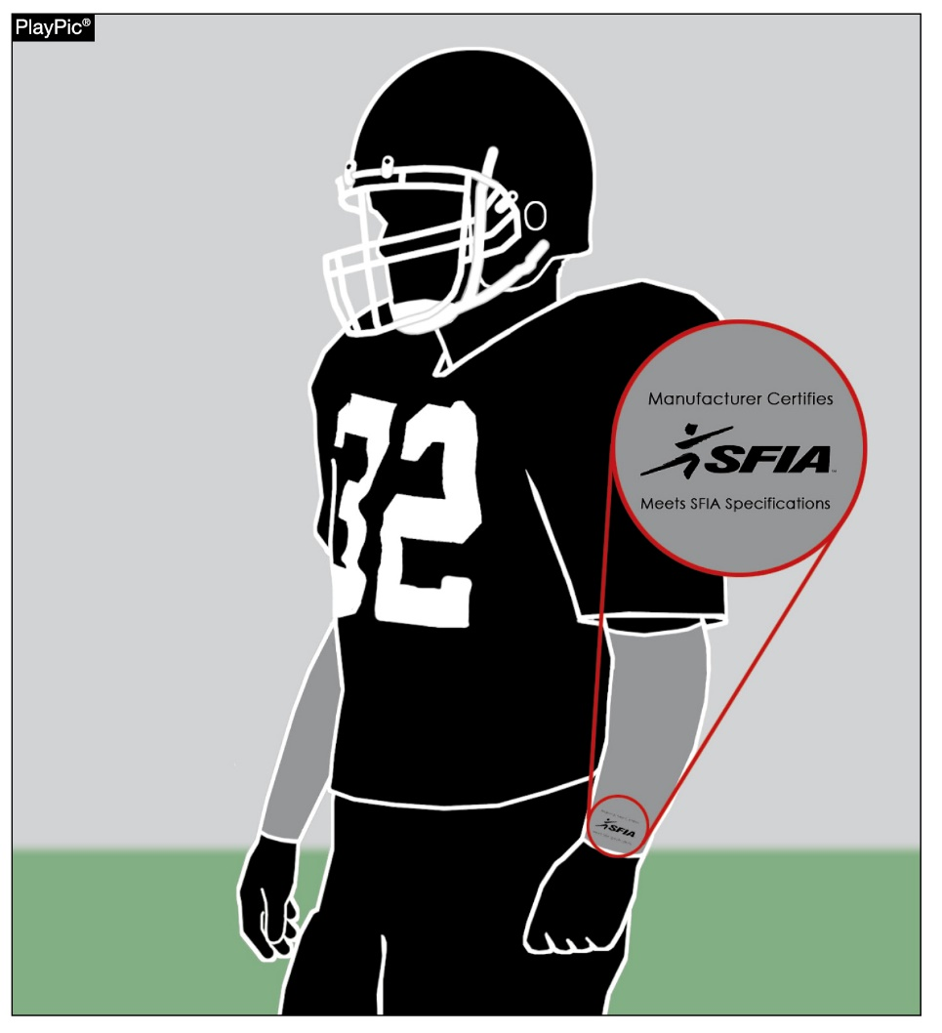
ARM SLEEVES
RULES 1-5-2d, 1-5-3c(6)
Effective 2027: Arm sleeves must have a permanent, exact replica of the SFIA arm sleeve seal (meets SFIA Specification), that must be visible and appear legibly on the exterior of the arm sleeve.
Notes:
RuleS Reminder:
See PlayPic and comments on slide.

Slide 20
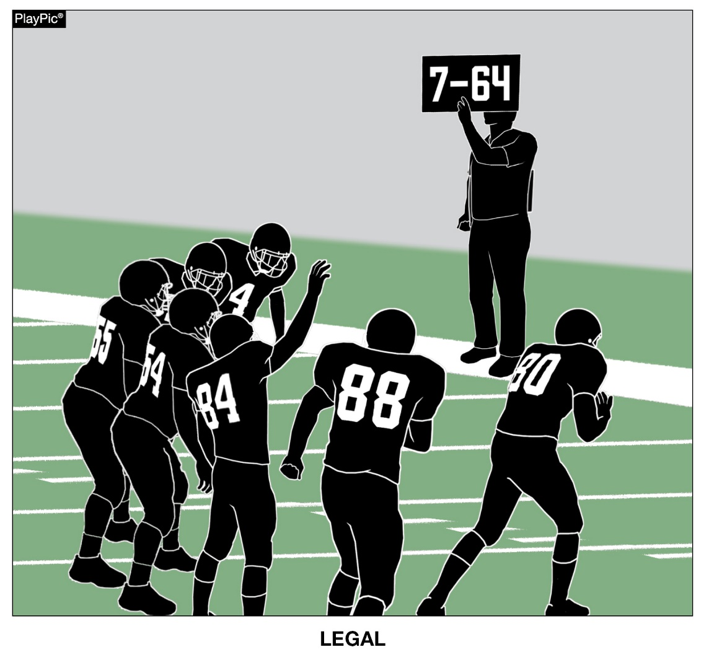
ELECTRONIC SIGNS
RULE 1-5-3c(2)
Fixed electronic signs (non-audio) with play signals are allowed to communicate from the sideline.
Notes:
RuleS Reminder:
See PlayPic and comments on slide.

Slide 21
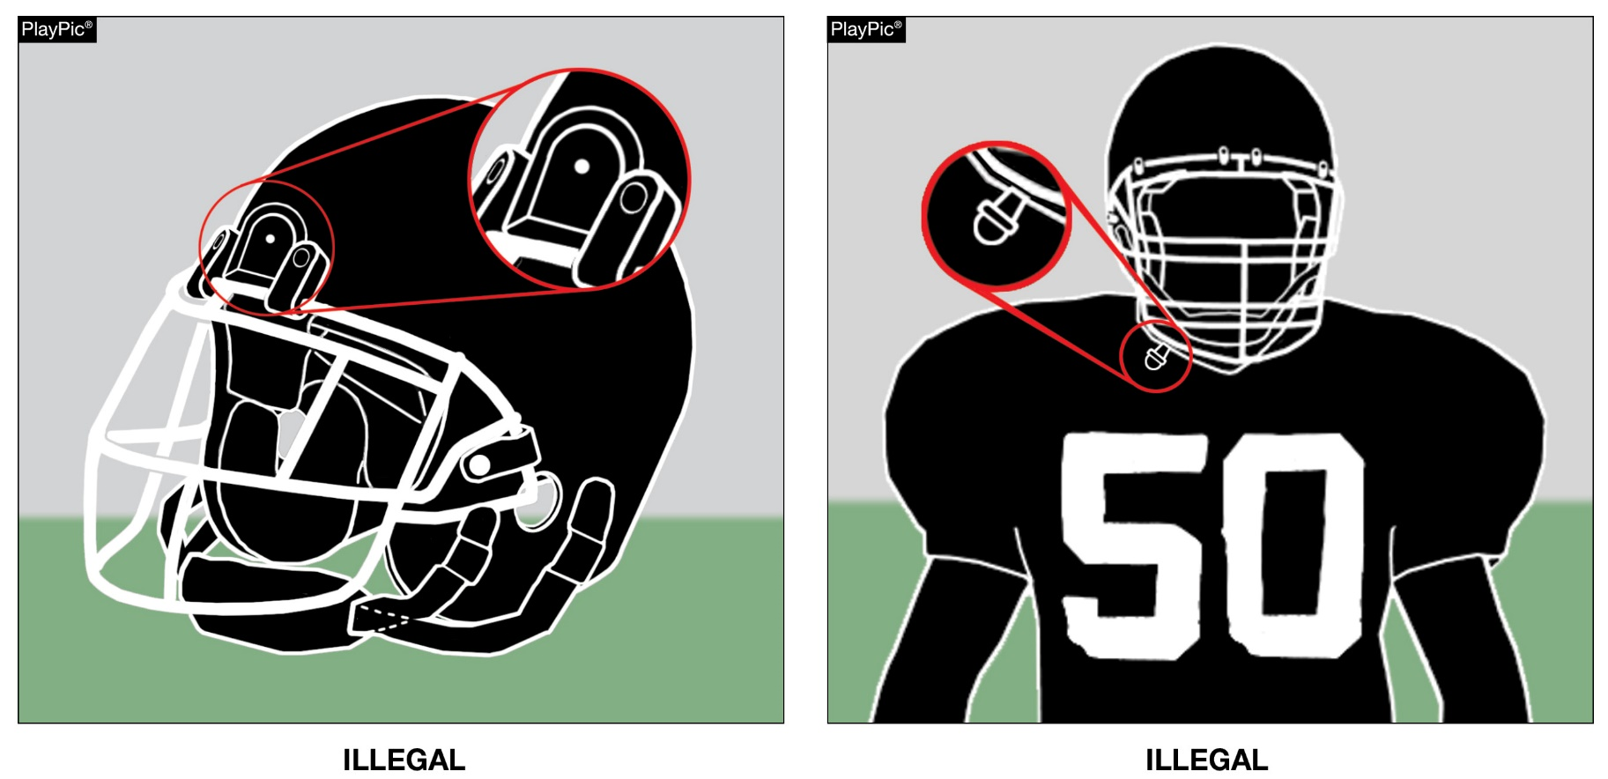
ILLEGAL EQUIPMENT
RULE 1-5-3c(3) (NEW)
Any video (camera) device or audio (microphone) worn by a player during the game is illegal.
Notes:
RuleS Reminder:
See PlayPics and comments on slide.

Slide 22
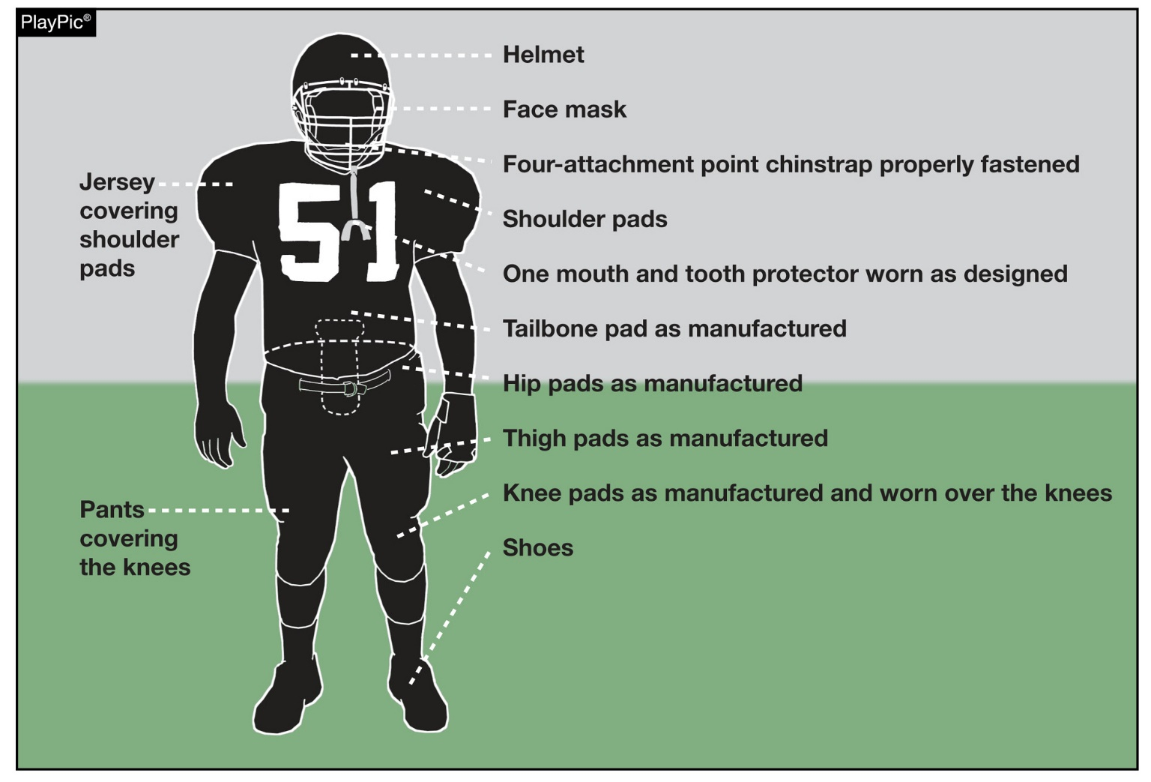
ILLEGAL AND IMPROPERLY WORN PLAYER EQUIPMENT
To support the safety of all participants, players must wear equipment and uniforms that are properly fitted and worn as intended by the manufacturer. Before starting each game, the head coach must verify that all players are properly and legally equipped. Allowing players to use illegal equipment or to wear required equipment improperly could subject the coach to a penalty.
Notes:
RuleS Reminder:
See PlayPic and comments on slide.

Slide 23
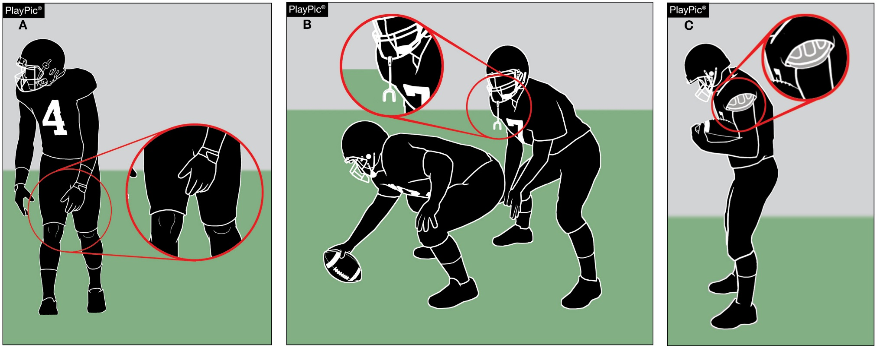
ILLEGAL AND IMPROPERLY WORN PLAYER EQUIPMENT
Improperly worn equipment pertains to all equipment that is otherwise legal but not worn as intended. Examples include pants not covering the knees, tooth and mouth protectors not being worn as play starts and shoulder pads not properly covered by the jersey.
Notes:
RuleS Reminder:
See PlayPics and comments on slide.

Slide 24
NJSIAA Guidance for IMPROPERLY WORN PLAYER EQUIPMENT
When players are found to have required equipment missing or worn improperly, per Rule 1-5-4, players shall be replaced for at least one down
HOWEVER, when players persistently disregard the equipment guidelines, there are several administrative options within current NFHS rules
Situation | Penalty | Example
Persistent violations that significantly impact the pace of play | Delay of Game | Sending 2 or more players from the same team off on the same down Sending players off from the same team multiple times during a possession
Chronic violations of equipment rules by players could result in an unsportsmanlike conduct foul being assessed under Rule 1-5-3c(10) and 9-8-1h, for equipment not worn as intended by the manufacturer. | USC (under Rule 1-5-3c(10) and 9-8-1h) charged to the offending Player | When a player is in violation more than 3 times
Coach who demonstrates a lack of interest in supporting these important rules of our sport | USC charged to the Head Coach | When the game is stopped 4 or more times for players who are in violation during a game

Slide 25
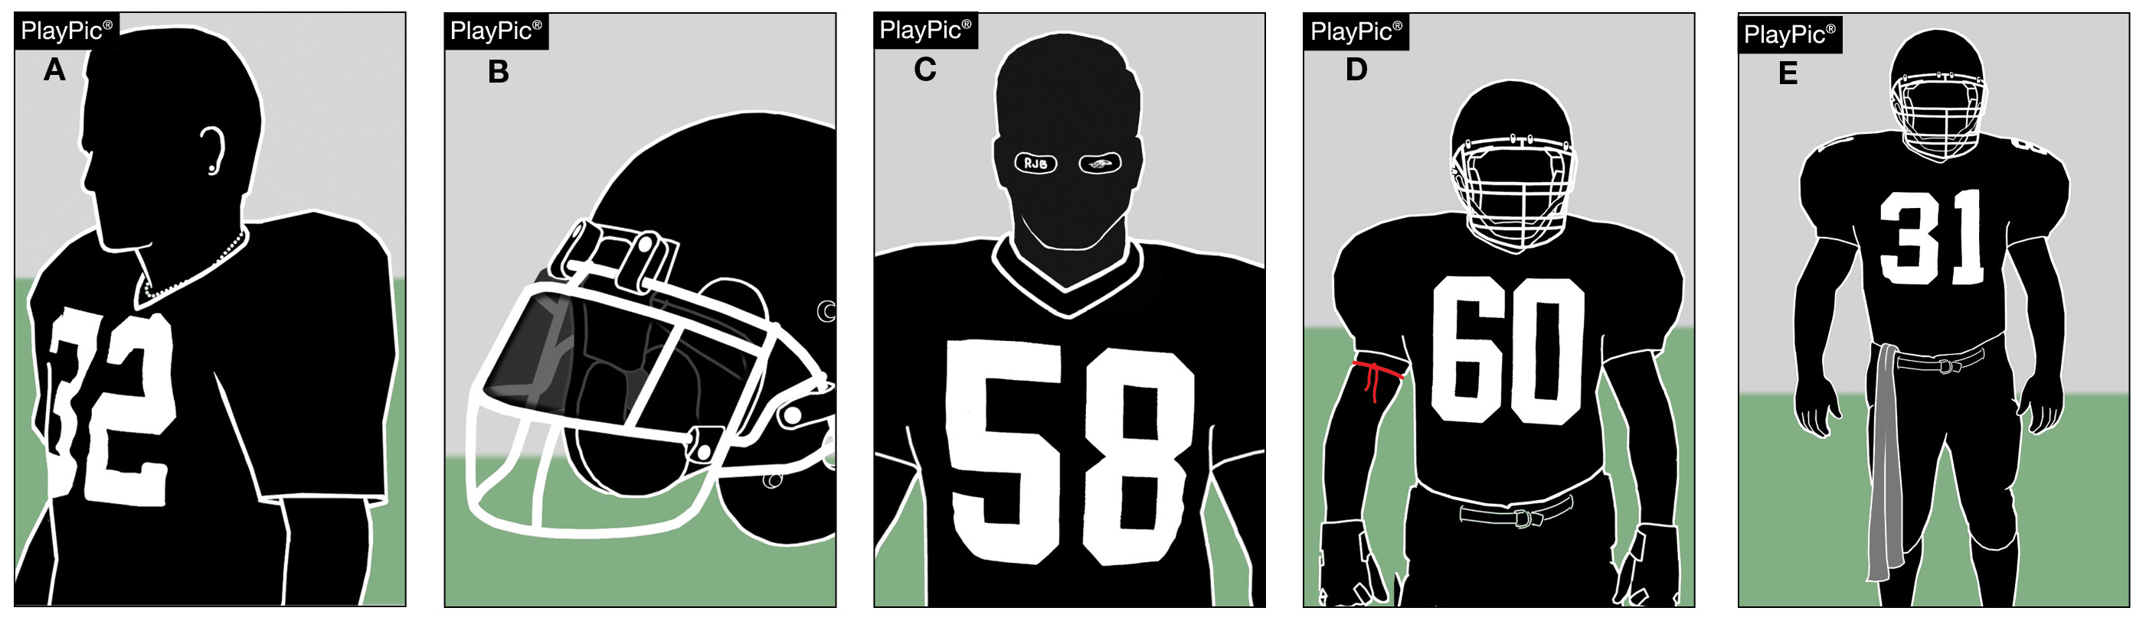
ILLEGAL AND IMPROPERLY WORN PLAYER EQUIPMENT
Illegal (prohibited) equipment includes jewelry (A), tinted visors (B), non-compliant eye shade (C), bands worn around the upper arm, neck or legs (D), and uniform adornments like towels that do not conform to rules (E).
Notes:
RuleS Reminder:
See PlayPics and comments on slide.

Slide 26
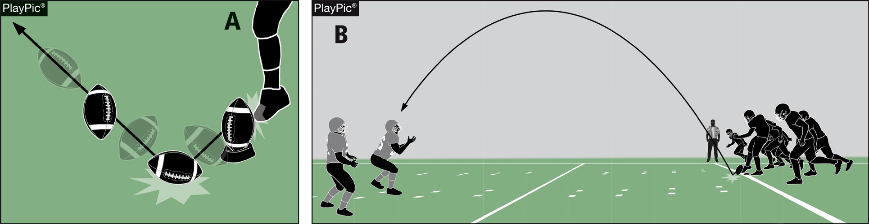
POP-UP KICK
RULES 2-24-10; 6-1-11; 6-1 PENALTY
A pop-up kick is a free kick in which the kicker drives the ball immediately to the ground, the ball strikes the ground once and goes into the air in the manner of a ball kicked directly off the tee. Such kicks are penalized as a dead-ball foul.
Notes:
RuleS Reminder:
See PlayPics and comments on slide.

Slide 27
2026 NFHS FOOTBALL POINTS OF EMPHASIS

Slide 28
2026 NFHS FOOTBALL POINTS OF EMPHASIS
1. Flagrant and Unsportsmanlike Fouls
2. Helping the Runner
3. Sideline Management and Control
4. Identification of the NFHS Authenticating Mark on Game Balls
Notes:
POINTS OF EMPHASIS:
Comment on Slide:
The following football points of emphasis were selected by the NFHS Football Rules Committee for the 2026 high school football season. These four football points of emphasis need to be stressed to all coaches, game officials, players, parents, school administrators, appropriate health-care professionals and all others who have an interest in high school football.

Slide 29
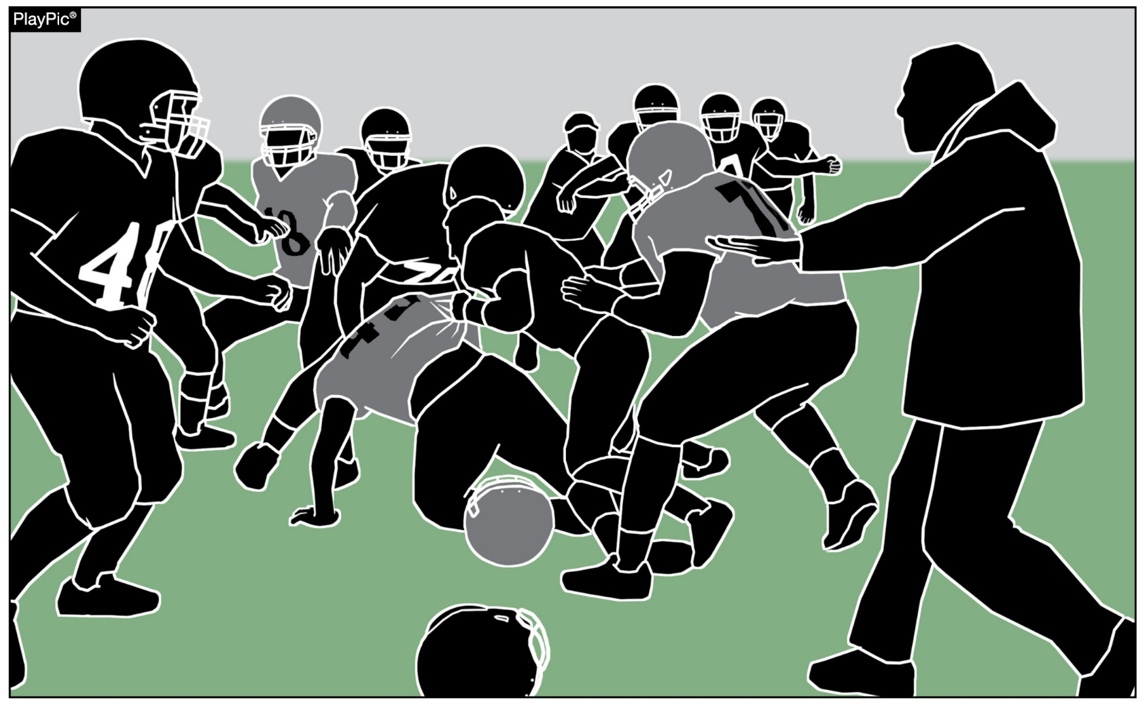
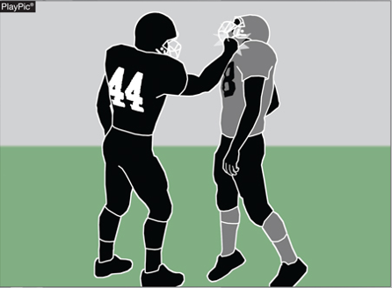
FLAGRANT AND UNSPORTSMANLIKE FOULS
In high school football, flagrant fouls and unsportsmanlike fouls are serious rule violations that threaten player safety and the integrity of the game.
Game officials must consistently penalize both flagrant and unsportsmanlike fouls to maintain control of the game.
Notes:
Flagrant and Unsportsmanlike Fouls (Point of Emphasis):
In high school football, flagrant fouls and unsportsmanlike fouls are serious rule violations that threaten player safety and the integrity of the game. The National Federation of State High School Associations (NFHS) places a strong emphasis on sportsmanship and risk minimization because players are still developing physically and emotionally. Game officials play a critical role in identifying and penalizing these fouls to ensure the game is played fairly, safely, and with respect for all participants.
Flagrant fouls are the most severe type of personal foul in high school football. These actions involve intentional, reckless or excessively violent behavior that shows a clear disregard for the safety of others. Flagrant fouls are fouls so severe or extreme that they place an opponent in danger of serious injury. They may also involve violations that are extremely or persistently vulgar or abusive. Examples include fighting, maliciously targeting the head or neck area, striking an opponent, or delivering a violent illegal blindside block or late hit. When a flagrant foul occurs, the penalty is 15 yards and automatic disqualification of the offending player. Removing players who commit flagrant fouls helps prevent serious injuries and stops situations from escalating into further violence.

Slide 30
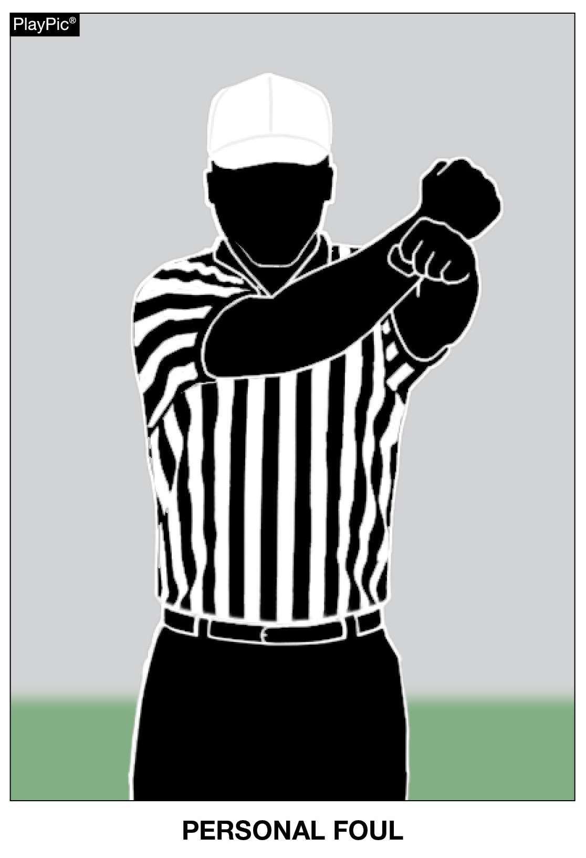
FLAGRANT AND UNSPORTSMANLIKE FOULS
Flagrant fouls are the most severe type of personal foul in high school football.
A foul so severe or extreme that it places an opponent in danger of serious injury, and/or involves violations that are extremely or persistently vulgar or abusive conduct.
These actions involve intentional, reckless or excessively violent behavior that shows a clear disregard for the safety of others. Examples include fighting, maliciously targeting the head or neck area, striking an opponent, or delivering a violent illegal blindside block or late hit.
Disqualification if any foul is judged by the game official to be flagrant.
Notes:
Flagrant and Unsportsmanlike Fouls (Point of Emphasis) - continued:
In high school football (NFHS rules), unsportsmanlike fouls are non-contact fouls that violate standards of fair play, respect and sportsmanship, while personal fouls are fouls that involve illegal personal contact. Unsportsmanlike fouls are penalized even if they don’t directly affect the play, and while they may not be physically violent, they harm the tone of the game. Common examples include:
• taunting,
• threatening gestures or posturing,
• racist comments,
• trash talking,
• excessive or choreographed celebrations,
• aggressively spiking, spinning or throwing the ball high into the air,
• using profanity,
• spitting,
• arguing with game officials, or
• throwing equipment.
Unsportsmanlike fouls can be committed by players, coaches or other team personnel. Each unsportsmanlike foul results in a 15-yard penalty, and a player who commits two such fouls in one game is disqualified.

Slide 31
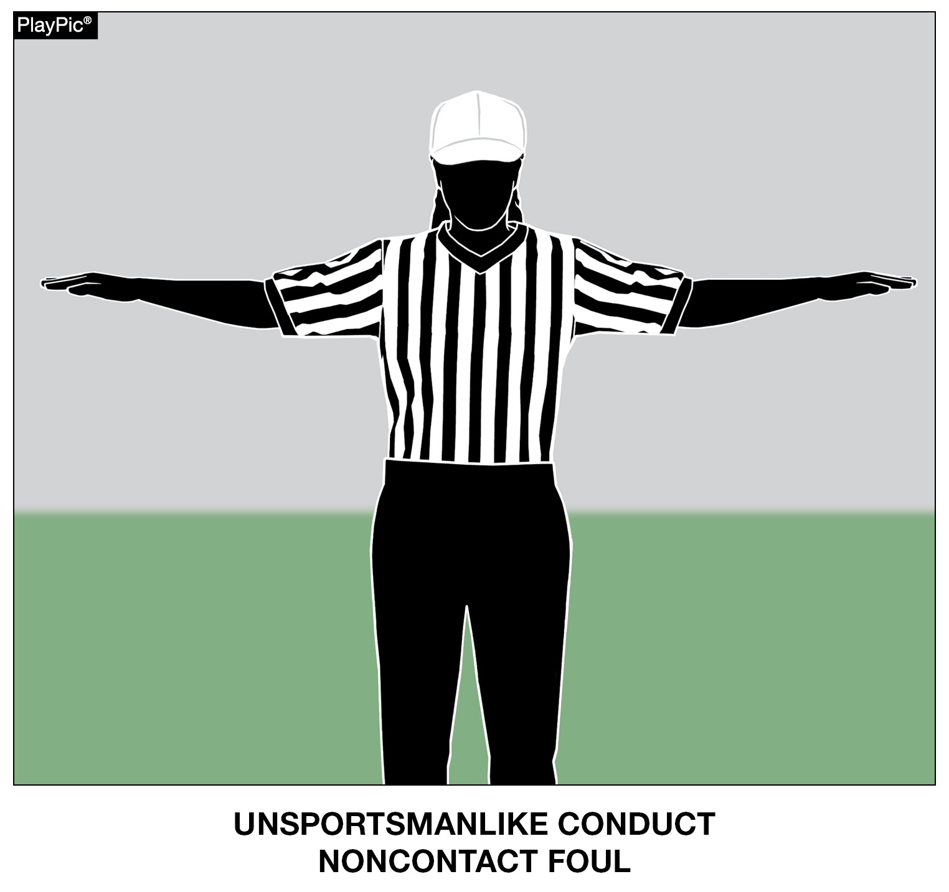
FLAGRANT AND UNSPORTSMANLIKE FOULS
Unsportsmanlike fouls are non-contact fouls that violate standards of fair play, respect and sportsmanship.
Common examples include taunting, threatening gestures or posturing, racist comments, trash talking, excessive or choreographed celebrations, aggressively spiking, spinning or throwing the ball high into the air, using profanity, spitting, arguing with game officials, or throwing equipment.
Notes:
Flagrant and Unsportsmanlike Fouls (Point of Emphasis) - continued:
Game officials must consistently penalize both flagrant and unsportsmanlike fouls to maintain control of the game. When these actions go unpunished, players may feel emboldened to act more aggressively or disrespectfully, increasing the risk of fights and injuries. Proper enforcement sends a clear message that dangerous or unsportsmanlike behavior will not be tolerated, helping to keep emotions in check and the game orderly.
Penalizing flagrant and unsportsmanlike fouls is important because high school football is about more than winning; it is about teaching values such as respect, discipline, and responsibility. By enforcing these rules, game officials protect players, promote good sportsmanship, and set a positive example for young athletes. Consistent enforcement helps ensure that high school football remains a safe, competitive and educational experience for everyone involved.

Slide 32
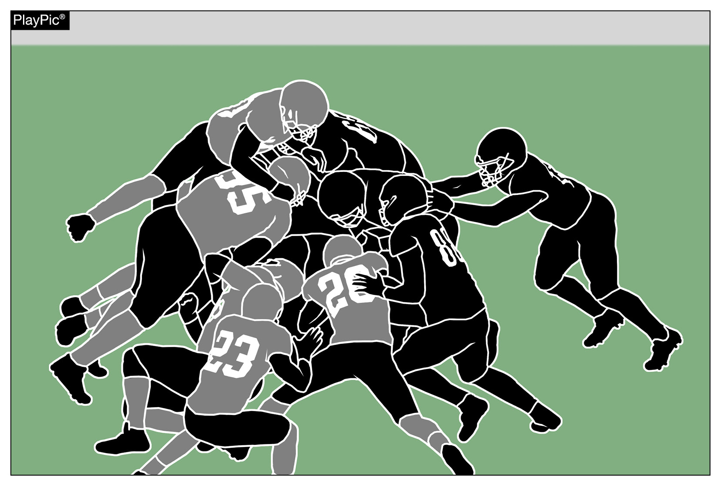
HELPING THE RUNNER
Illegally helping the runner to assist forward progress presents a risk of injury to the runner and others. The additional momentum to a particular offensive player, as opposed to the pile, swings the competitive balance toward the offense in a manner not intended by the rules.
Notes:
Helping the Runner (Point of Emphasis):
Collegiate and professional football rules allow offensive players to pile in behind and directly push the runner. The “tush push” is an example of such a play often used at those levels. Although illegal under NFHS rules, these plays are becoming more common in the high school game. As guardians of the game, it is imperative that all stakeholders work together to remove “illegally helping the runner” from our high school game.
Administrators, coaches and football game officials all have a responsibility to know, respect and teach/enforce the NFHS rules of high school football. Football is a vigorous, physical contact game and, for this reason, much attention is given to minimizing risk of injury to all players. Each respective rules code (NFL, NCAA and NFHS) has rules that coincide with the physical development of competing athletes and their goals for the game.
The NFHS Football Rules Committee focuses on minimizing risk and supporting a balance between offensive and defensive rules. Illegally helping the runner to assist forward progress presents a risk of injury to the runner and others. The additional momentum to a particular offensive player, as opposed to the pile, swings the balance toward the offense in a manner not intended by the rules.

Slide 33
HELPING THE RUNNER
Although direct contact with the runner is illegal under NFHS rules, these types of plays are becoming more common in the high school game. As guardians of the game, it is imperative that all stakeholders work together to remove “illegally helping the runner” from our high school game.
Notes:
Helping the Runner (Point of Emphasis) - continued:
Football game officials should be aware of ruling plays dead when a runner’s forward progress is clearly stopped, and they should penalize actions by offensive teammates who directly contact the runner and push, pull or lift the runner forward in a clear and obvious attempt to keep the runner’s progress moving forward.
Of course, not all contact with the runner is illegal. Game officials should observe and judge an offensive teammate’s actions and the runner’s progress to determine whether a foul for illegally helping the runner is warranted. Although a foul can occur on any play, game officials should especially be alert for this type of action on short-yardage plays near the goal line and line to gain. Remember, pushing the pile is legal; direct contact while pushing, pulling, lifting of the runner to assist forward progress is not.

Slide 34
HELPING THE RUNNER
Although a foul can occur on any play, game officials should especially be alert for this type of action on short-yardage plays near the goal line and line to gain. Remember, pushing the pile is legal; direct contact while pushing, pulling, lifting of the runner to assist forward progress is not.
Notes:
Helping the Runner (Point of Emphasis) - continued:
The NFHS Coaches Code of Ethics states: “Coaches shall master the contest rules and shall teach the rules to their team members. Coaches shall not seek an advantage by circumvention of the spirit or letter of the rules. Coaches have a tremendous influence, for good or ill, on the education of the student, and thus shall never place the value of winning above the value of instilling the highest ideals of character.”
If school administrators/athletic directors truly believe that activities are an extension of the classroom, they must be actively involved with programs they supervise and redirect coaches when they observe them teaching prohibited tactics.
Removing “illegally helping the runner” from high school football will, at times, be met with resistance, especially considering the visibility of this type of play at other levels of the game. School administrative support of football game officials, re-focus of coaches and education of players will lead to a smooth transition. All stakeholders must remain committed to trying to minimize risk to all players and maintain the balance between offensive and defensive play.

Slide 35
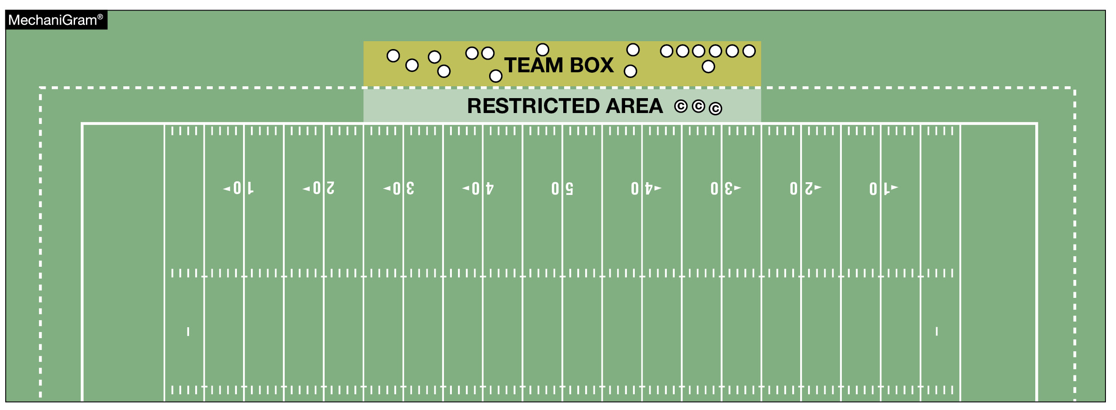
SIDELINE MANAGEMENT AND CONTROL
Sideline management has become a recurring “point of emphasis” because it improves game safety. To minimize the risk of all involved, non-players must remain in their team box and out of any restricted areas, especially while the ball is live. The coaches’ area is a minimum of a 2-yard belt between the front of the team box and the sideline, and becomes the restricted area when the ball is live. A maximum of three coaches – and only coaches – may be in this area when the ball is dead between plays.
Notes:
Sideline Management and Control (Point of Emphasis):
Sideline management has become a recurring “point of emphasis” because it improves game safety by keeping game officials, players, coaching staff and other team personnel clear of the active game play areas. It promotes good sportsmanship and professionalism across all levels of play and also prevents unnecessary
delays and confrontations that can impact game flow and fairness.
The sideline includes the team area and any restricted zones around the field where players and coaches stand during the game. Game officials expect this area to be organized and kept clear of unnecessary personnel. Coaches must remain in the designated team area when interacting with game officials, especially for rule discussions. Leaving that area to step onto the field or challenge calls results in an automatic unsportsmanlike conduct foul. Coaches are generally only allowed to step toward the sideline (into the working area, often a marked 2-yard border) to call offensive or defensive signals after play has stopped.
Game officials are instructed to strictly enforce NFHS Football Rules when the following behaviors are observed:
• Coaches or team personnel entering the field of play to dispute rulings or address game officials outside the coaching area.
• Prolonged or excessive celebrations or demonstrations that carry onto the field.
• Failing to maintain professional behavior. Coaches and team personnel are expected to set a standard for sportsmanship.
• Game officials shall call fouls for violations of sideline control when they are observed.

Slide 36
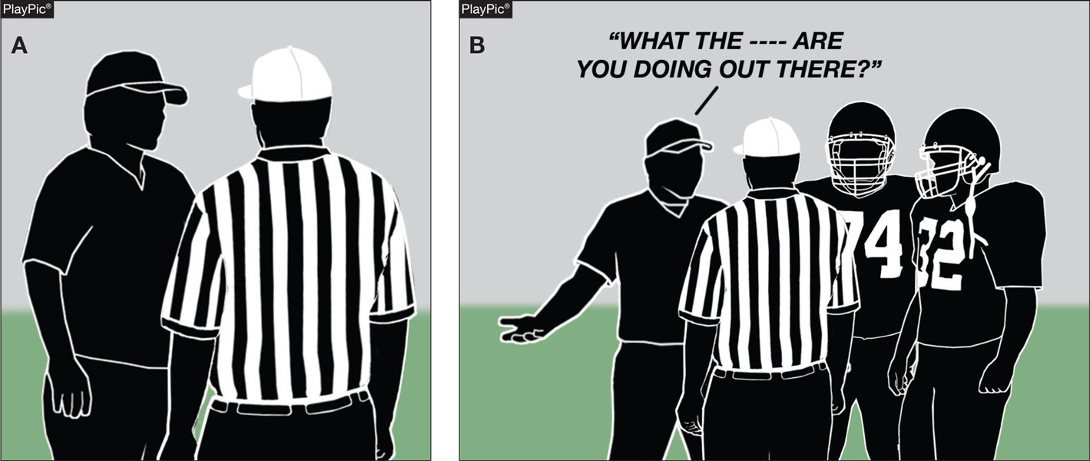
SIDELINE MANAGEMENT AND CONTROL
Game officials are instructed to strictly enforce NFHS Football Rules when coaches or team personnel enter the field of play to dispute rulings or address game officials outside the coaching area.
Notes:
Sideline Management and Control (Point of Emphasis) - continued:
• Infractions such as approaching game officials with devices (e.g., to view or review video).
The following is a summary checklist for coaches/teams to follow during a game:
• Remain inside your team area for game official discussions.
• Only move toward the sideline after play is dead, and for signal/play calling.
• Keep non-essential personnel and spectators off the field level.
• Avoid approaching game officials during play or with electronic/video devices.
• Set a professional, sportsmanlike example for the entirety of the contest.
To minimize the risk of all involved, non-players (including substitutes, athletic trainers and coaches) must remain in their team box and out of any restricted areas, especially while the ball is live. Non-players may never be on the field while the ball is live and may only be on the field when the ball is dead in very limited situations. In the excitement of the game, it is not uncommon for substitutes and other non-players to move closer to the sideline beyond their team box area. This inevitably causes coaches to move up into restricted areas and closer to the field - often impeding game officials in their essential duties. Crowding at the sideline puts players, non-players, coaches and game officials in danger of severe injury. Game officials and coaches must be aware of this problem and take the necessary steps to prevent and correct these occurrences. Coaches, substitutes, athletic trainers and others affiliated with the team may be in their team’s area, which is out-of-bounds and between the 25-yard lines (unless otherwise approved to be adjusted by state association adopted policy). Their movements and positions are limited by this designated area.

Slide 37
SIDELINE MANAGEMENT AND CONTROL
Sideline management and control promotes good sportsmanship and professionalism across all levels of play, and also prevents unnecessary delays and confrontations that can impact game flow and fairness.
Notes:
Sideline Management and Control (Point of Emphasis) - continued:
The coaches’ area extends at least a 2-yard depth out-of-bounds from the sideline. A maximum of three coaches – and only coaches – may be in this area when the ball is dead between plays. However, all coaches must leave this area when the ball is about to become live, such as when the snapper is approaching the ball, and no one may be in this area while the ball is live. The team box area is outside the field, beyond the restricted area and between the 25-yard lines. All coaches and non-players associated with the team may be in this area. A nonplayer may not be outside of this area unless to become a player or return as a replaced player.
When nonplayers are outside of the team box area, or anyone is in the restricted area while the ball is live, game officials will give a sideline warning to the team involved. A second offense results in a 5-yard penalty. All subsequent offenses result in 15-yard penalties for unsportsmanlike conduct fouls, which are charged to the head coach. If a game official unintentionally contacts a coach or other nonplayer in the restricted area while the ball is live, the team is assessed a 15-yard penalty for a nonplayer, illegal personal contact foul. As a nonplayer foul, the penalty is enforced from the succeeding spot. A second such offense would result in the head coach’s disqualification. Unlike a foul for sideline interference (non-contact, Rule 9-8-1k or 9-8-3), no warning or 5-yard penalty is required in this situation.

Slide 38
IDENTIFICATION OF NFHS AUTHENTICATING MARK ON GAME BALLS
The NFHS Authenticating Mark ensures easy identification of inflated and non-inflated balls used in interscholastic competition for which the NFHS writes playing rules. All such balls are required to display the NFHS Authenticating Mark.
Notes:
Identification of NFHS Authenticating Mark on Game Balls (Point of Emphasis):
The NFHS Authenticating Mark ensures easy identification of inflated and non-inflated balls used in interscholastic competition for which the NFHS writes playing rules. All such balls are required to display the NFHS Authenticating Mark.
The use of conforming equipment is essential to the integrity of contests played under the NFHS rules. This mark helps to promote a level playing field by ensuring consistency in the equipment being used. The mark allows for the development of more sophisticated standards in balls and clearly communicates to administrators, coaches, and game officials that these standards are being met.
Non-compliance with these requirements will be reported to the state association for potential penalties, following the contest. Administrators and coaches play a pivotal role in making sure all inflated and non-inflated balls meet these specifications. They must instill the importance of proper equipment use through consistent reinforcement during the pre-competition certification meeting and throughout the season. Game officials must also remain vigilant and report any non-compliant balls to the state association office.

Slide 39



NFHS Authenticating Mark Update
Specifications
Do not use the NFHS Authenticating Mark without prior written approval from the NFHS
This mark is for use of licensees only.
Minimum size
  Inflatable Balls - 2 ½“ in length (Basketball, Football, Soccer, Volleyball, and Water Polo)
  Non-Inflatable Balls - 1 ¼" in length (Baseball, Field Hockey, Ice Hockey Puck, Lacrosse, and Softball)
  On a ball or puck, the NFHS mark may be smaller than manufacturer’s logo, but should be placed in proximity to the manufacturer’s name for easy identification. Allow enough space around the mark so it can be easily recognized as distinct and separate.
  Reproduce the mark only from the vector artwork provided on Direct Licensing Hub. Do not copy, scan art electronically or use as a template to redraw the symbol.
Note: If sizing or specifications do not work well in your particular design situation, contactK12 Licensing.
Old Logos
Current Logo
Notes:
Identification of NFHS Authenticating Mark on Game Balls (Point of Emphasis) - continued:
See comments on slide.

Slide 40
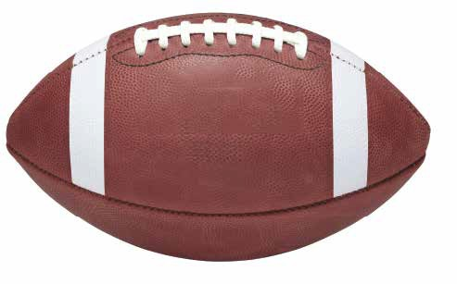


Football
Old Size
Current Size
1.25”
2.5”
10.875”
10.875”
Notes:
Identification of NFHS Authenticating Mark on Game Balls (Point of Emphasis) - continued:
See comments on slide dealing with the size of the NFHS Authenticating Mark Logo on the ball.

Slide 41
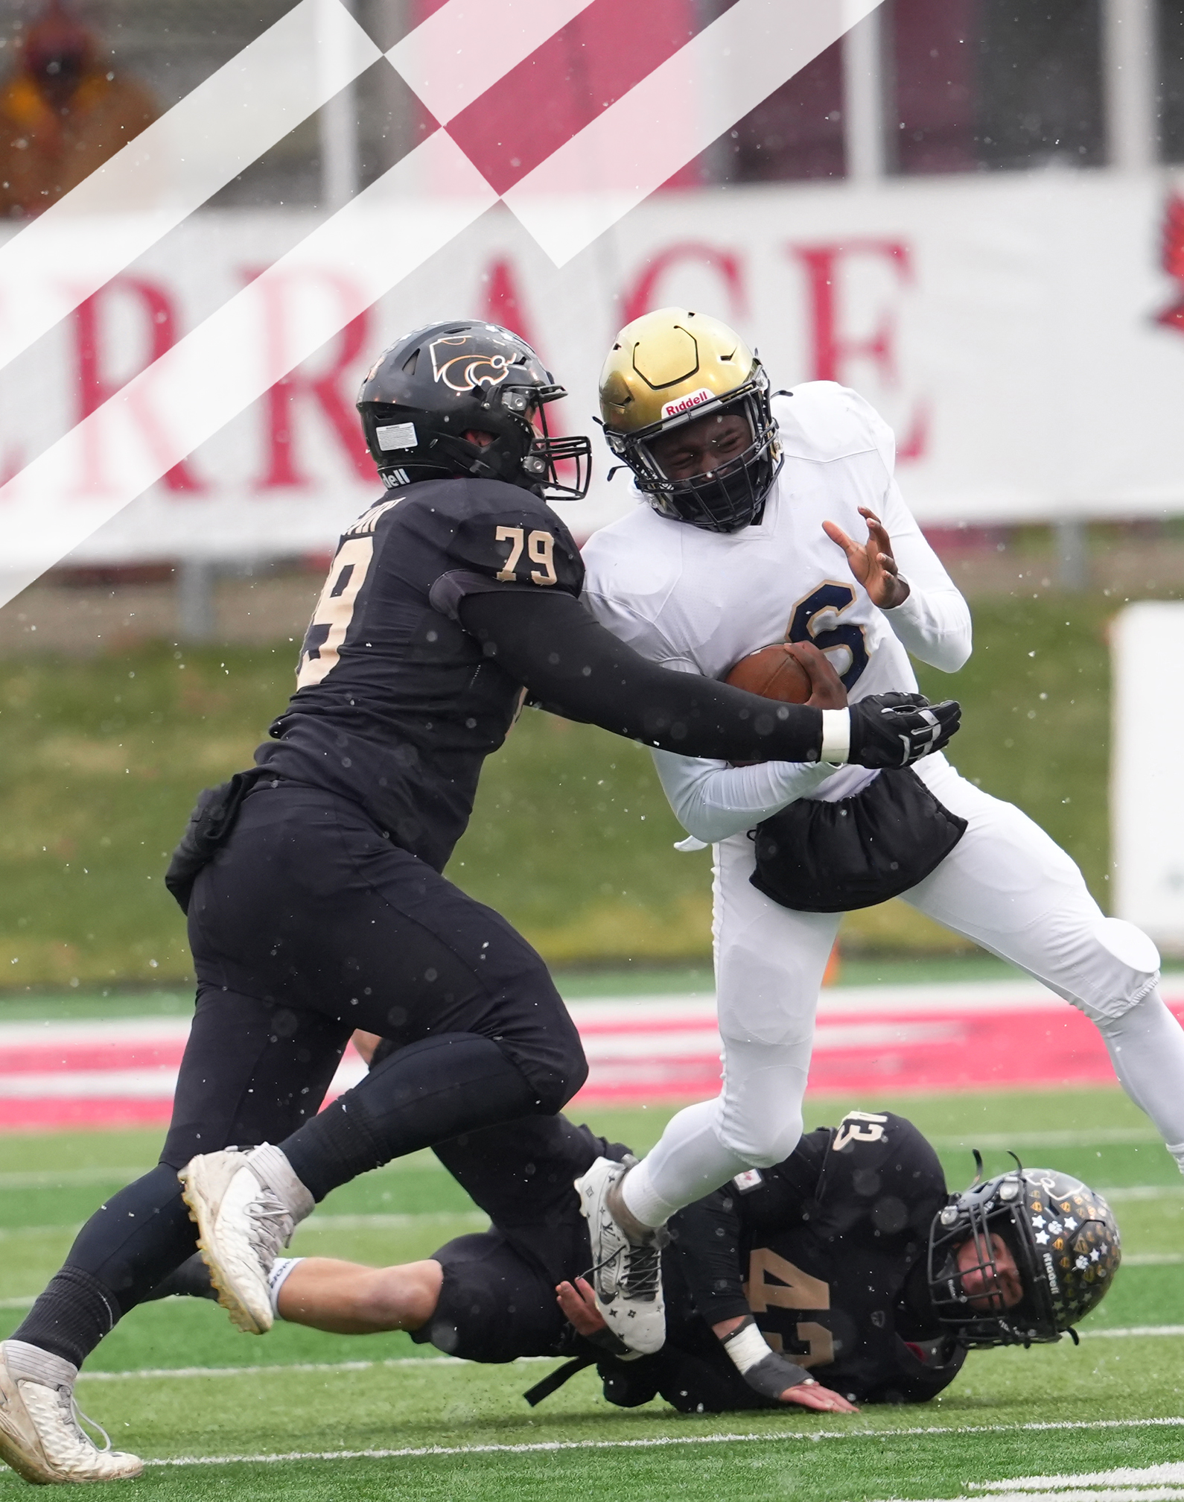
2026 NFHS FOOTBALL RULES REMINDERS and EQUIPMENT ITEMS

Slide 42
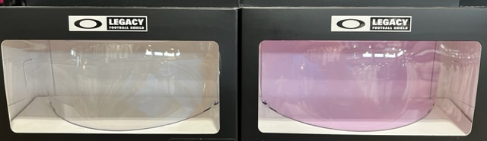
Oakley football visor (prizm clear)
LEGAL
ILLEGAL

Slide 43
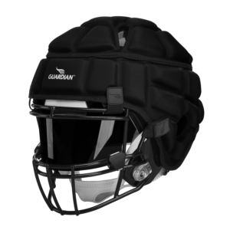
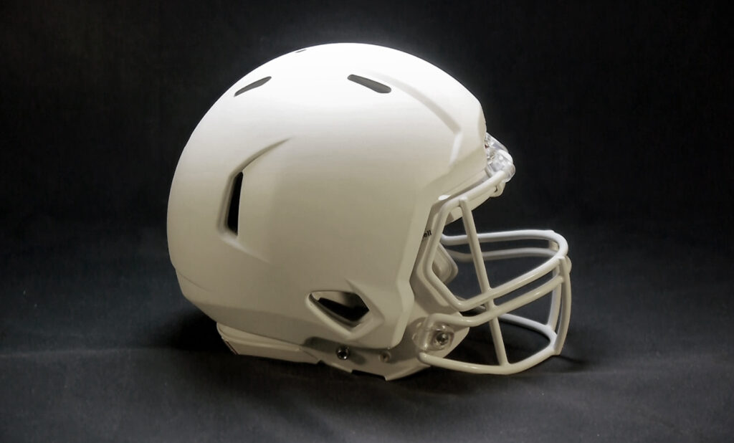
Football helmet covers
Permissible by current NFHS Football Rules
GUARDIAN CAPS
SAFR PRO TECH
Notes:
Comment on Slide:
See comments on the slide.

Slide 44
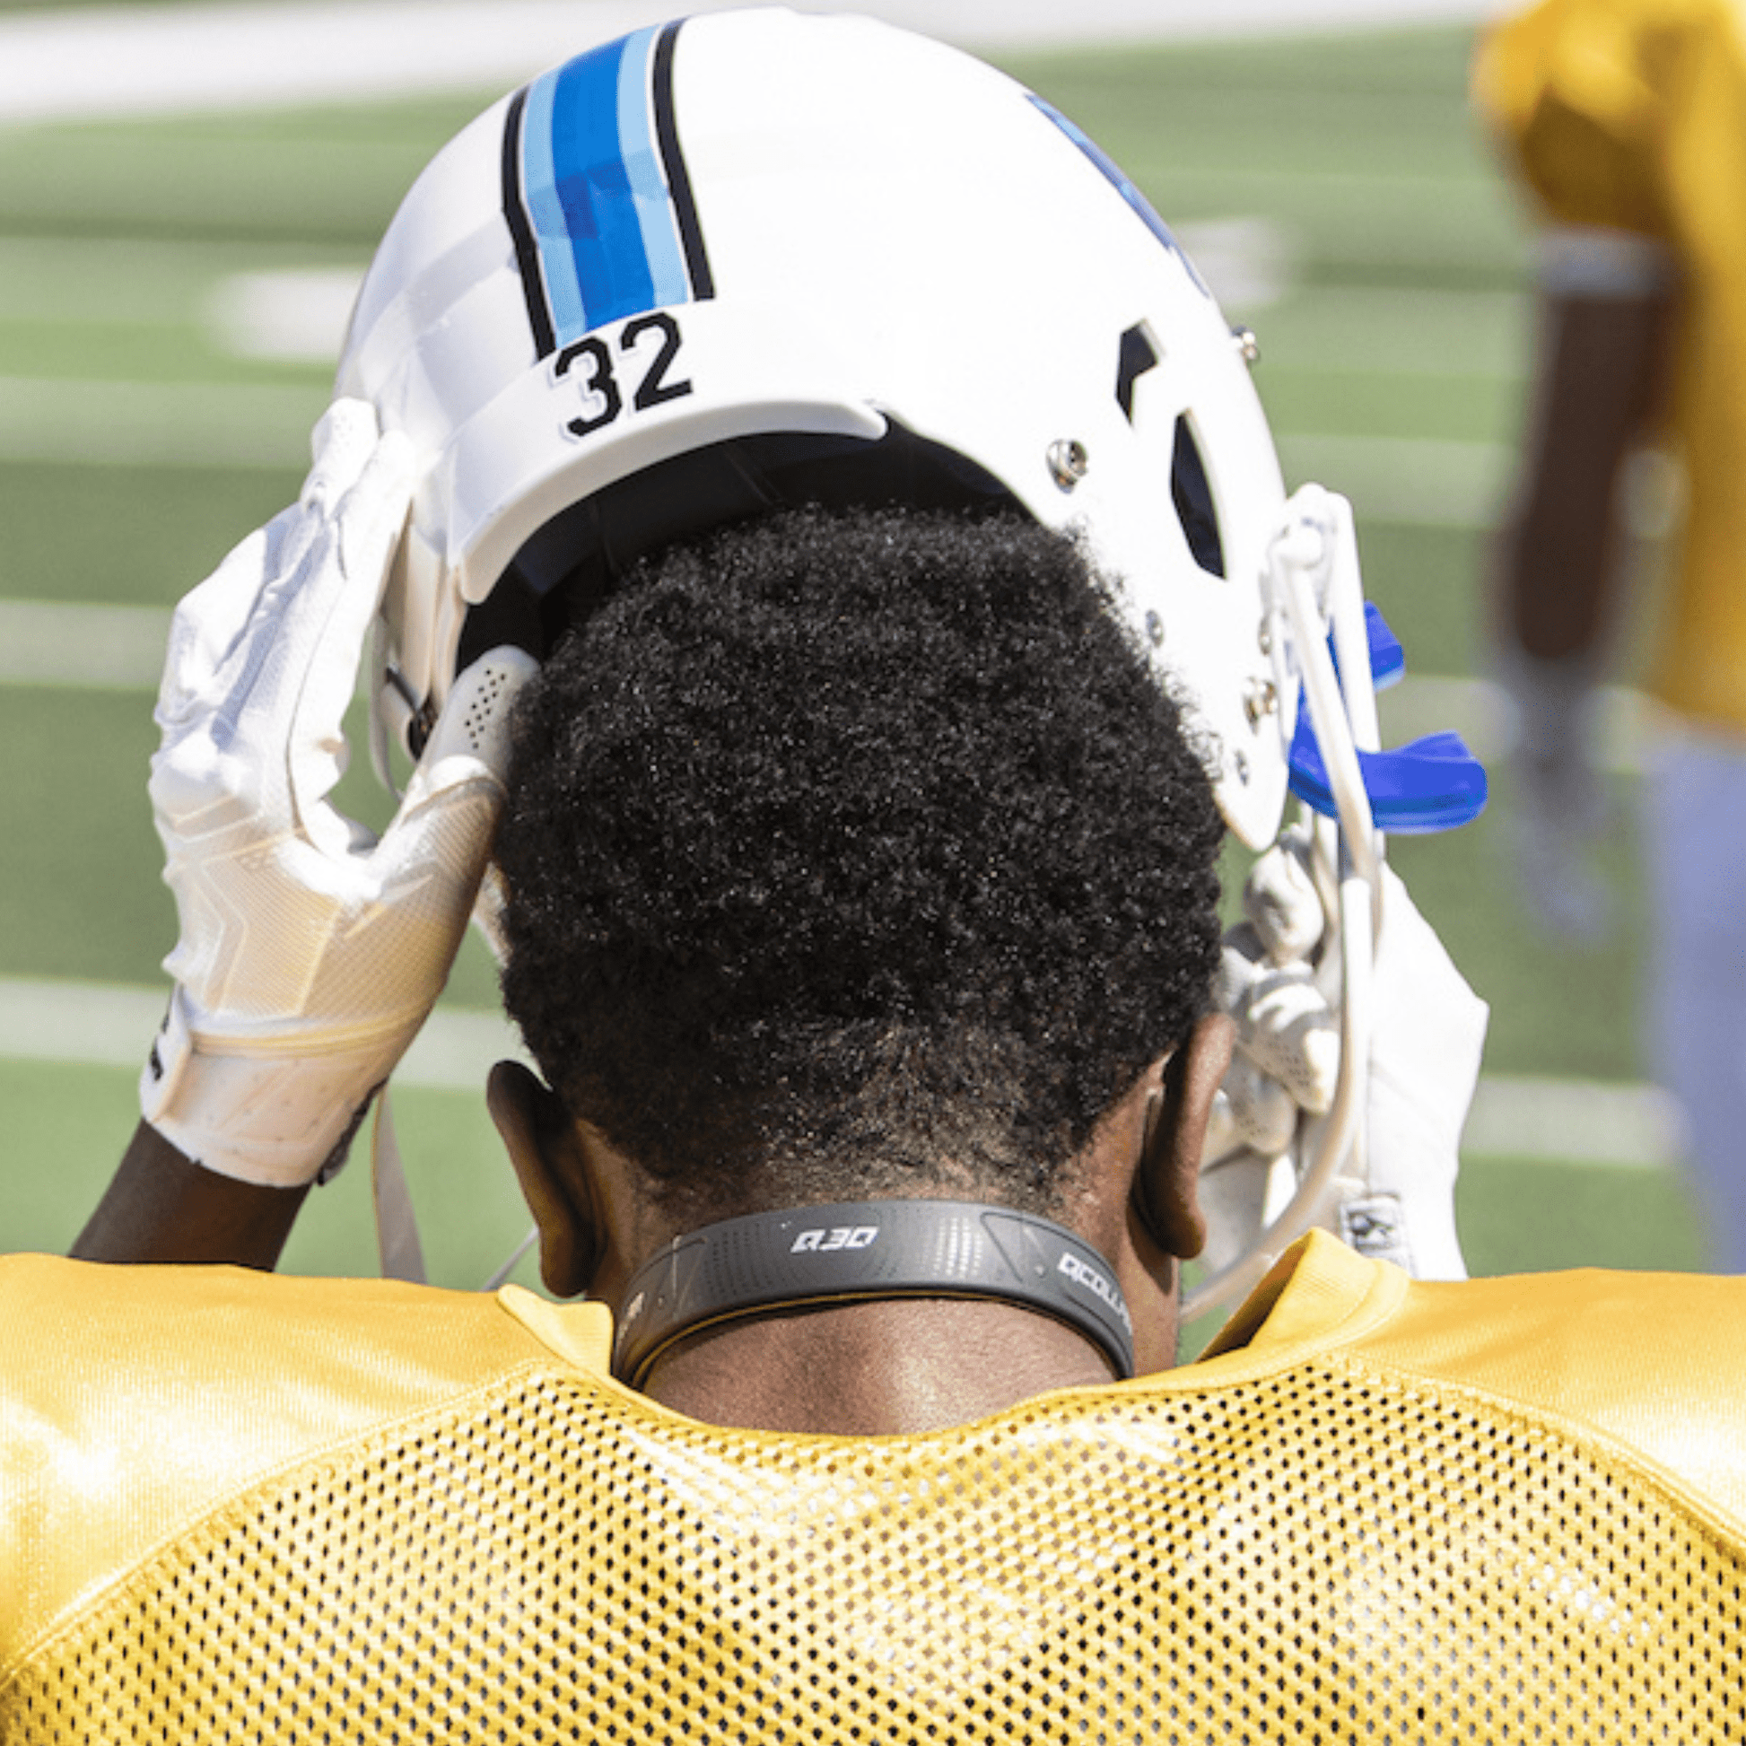
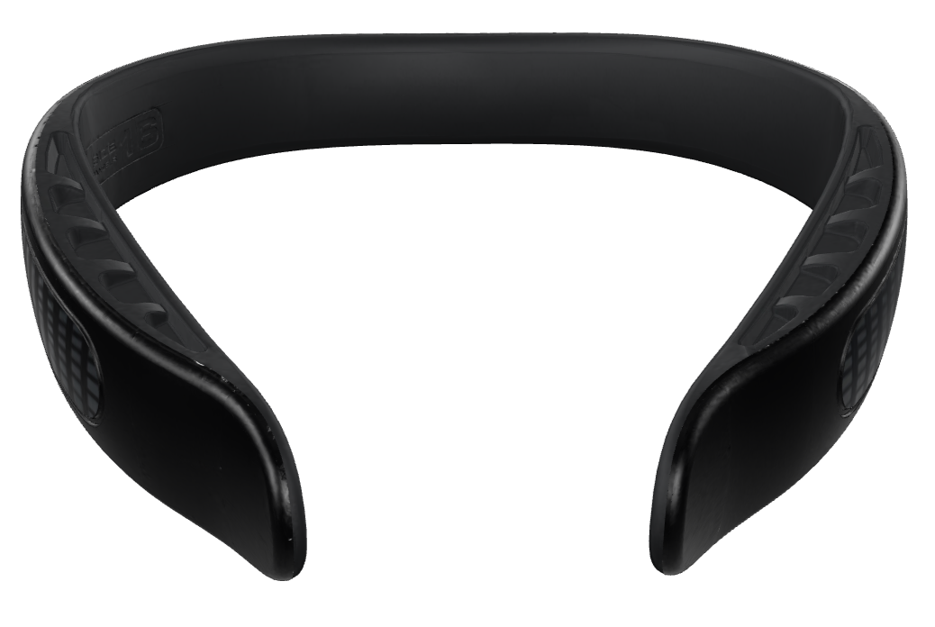
Q-COLLAR
Permissible by current NFHS Football Rules
Notes:
Comment on Slide:
See comments on the slide.

Slide 45
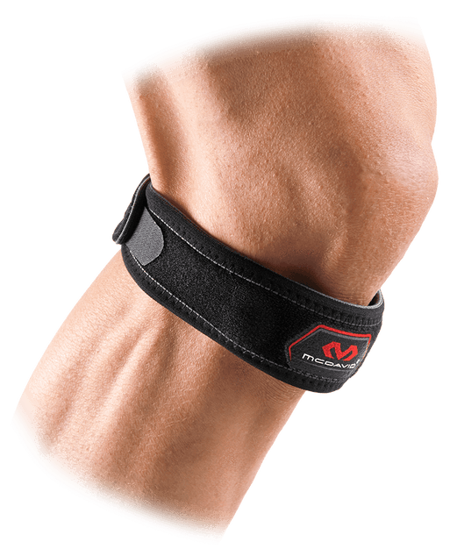
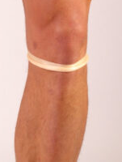
PATELLAR TENDON STRAPS
Patellar tendon straps are permissible by current NFHS Football Rules and is not considered an illegal equipment adornment.
Notes:
Comment on Slide:
See comments on the slide.

Slide 46
2026-27 NFHS FOOTBALL INFORMATION

Slide 47
2027 nfhs football rule change proposal online form
Due to me:
October 15, 2026
Must be submitted to your state association office for approval.
Notes:
Comment on Slide:
ALL 2027 NFHS Football Rule Change Proposal Online Forms must first go through the state association office before it can be sent to the NFHS.
Only member state associations, football coaches and football game officials approved by the member state association, members of the NFHS Football Rules Committee and the NFHS can submit football rule change online proposal forms.
ALL 2027 NFHS Football Rule Change Online Proposal Forms must be submitted electronically online to the NFHS by November 1, 2026.

Slide 48
Thank You
NFHS.org Phone # 317-972-6900 Email

